Slide 1
Outcomes of Axicabtagene Ciloleucel in Comparison with Chemoimmunotherapy in an Elderly Population for Treatment of Relapsed or Refractory Large B-cell Lymphoma after Two or More Lines of Prior Therapy
Abstract 765
Matthew A. Lunning, DO¹*; Hai-Lin Wang, MPH²*; Zhen-Huan Hu, MPH²; Frederick L. Locke, MD³; Tanya Siddiqi, MD⁴; Caron A. Jacobson, MD, MMSc⁵; Sairah Ahmed, MD⁶; David B. Miklos, MD, PhD⁷; Yi Lin, MD, PhD⁸; Brian T. Hill, MD, PhD⁹; Armin Ghobadi, MD¹⁰; Sattva S. Neelapu, MD⁶; Jason R. Westin, MD⁶; Harry Miao, MD, PhD²; Shilpa Shahani, MD²; Anik R. Patel, PhD²; Clare Spooner, MBBS, BSc²; Christine Fu, PhD²; Hairong Xu, MD, PhD²; Marcelo Pasquini, MD, MS¹¹
¹University of Nebraska, Omaha, NE, USA; ²Kite, a Gilead Company, Santa Monica, CA, USA; ³Moffitt Cancer Center, Tampa, FL, USA; ⁴City of Hope National Medical Center, Duarte, CA, USA; ⁵Dana-Farber Cancer Institute, Boston, MA, USA; ⁶The University of Texas MD Anderson Cancer Center, Houston, TX, USA; ⁷Stanford University School of Medicine, Stanford, CA, USA; ⁸Mayo Clinic, Rochester, MN, USA; ⁹Cleveland Clinic Foundation, Cleveland, OH, USA; ¹⁰Washington University School of Medicine, St Louis, MO, USA; ¹¹Center for International Blood and Marrow Transplant Research, Medical College of Wisconsin, Milwaukee, WI, USA
*Equal contributors.

Slide 2
Background
The poor clinical and survival outcomes of patients with LBCL refractory to CIT were demonstrated through the international SCHOLAR-1 study, highlighting unmet medical need¹
Based on the registrational ZUMA-1 Phase 1/2 study, axi-cel, an autologous anti-CD19 CAR T-cell therapy, was approved for the treatment of adults with R/R LBCL after ≥2 lines of systemic therapy and recently, in the United States and EU, for R/R LBCL within 12 months of first-line CIT based on the Phase 3 ZUMA-7 study²⁻⁵
Axi-cel showed durable responses versus non–CAR T-cell salvage regimens (83% vs 34% ORR, respectively) and marked survival benefit (54% vs 20% 2-year OS rate), with a 73% reduction in the risk of death, when 2-year outcomes were compared between ZUMA-1 versus SCHOLAR-1⁶
In a subgroup analysis of ZUMA-7, axi-cel demonstrated superiority over 2L standard of care in patients ≥65 years, with almost triple the proportion of axi-cel patients receiving definitive therapy versus standard of care⁷
In the 3L+ setting, a favorable ORR with axi-cel was observed among patients aged ≥65 years compared with younger patients (OR, 1.39; 95% CI, 1.05-1.83) in a CIBMTR analysis⁸
Here, we evaluate and compare the effectiveness outcomes of treatment with either axi-cel or CIT in an elderly population in real-world settings

Slide 3
Study Design
Data Source
Axi-Cel Retrospective observational data from patients who received commercial axi-cel in the US after ≥2 lines of therapy identified between October 2017 and August 2020 using the CIBMTR registry | CIT SCHOLAR-1 analysis (rebased to those with ≥2 lines)
Statistical Analysis
Primary Analysis: Propensity Score Matching¹ Baseline distributions were balanced for the following covariatesª Age (<65 years vs ≥65 years) ECOG performance status (0-1 vs ≥2 vs unknown) Disease histology (DLBCL vs PMBCL vs tFL) Disease stage at initial diagnosis (I or II vs III or IV vs unknown) Refractory to all prior lines of therapy (yes vs no) Prior ASCT (for the Response Rate Analysis set; yes vs no) Descriptive analyses: proportions and Kaplan-Meier estimates Sensitivity Analysis: Multivariable Analysis Logistic and Cox regressions
Endpoints of Interest
ORR CR rate OS

Slide 4
Analysis Population
Axi-Cel
CIT
Patients with R/R LBCL treated with commercial axi‐cel at 79 centers Oct 2017-August 2020 N=1497
Patients with R/R LBCL treated with CIT 2001-2014 N=539
Patients excluded (n=351)
Disease histology other than DLBCL, PMBCL, or tFL (n=206)
Missing or <2 prior lines of therapy (n=124)
Prior alloSCT (n=21)
Patients excluded
(n=70)
Disease histology other than DLBCL, PMBCL, or tFL (n=36)
Missing therapy start date (n=34)
Full analysis
N=1146
Full analysis
N=469
Patients included after propensity score matching
Response rate analysis: N=493
Survival analysis: N=659
Patients included after propensity score matching
Response rate analysis: N=289
Survival analysis: N=406
Among all patients, median follow-up was 24 months for axi-cel recipients and 60 months for CIT recipients
Among patients ≥65 years, median follow-up was 24 months and 65 months for axi-cel and CIT recipients, respectively

Slide 5
Baseline Characteristics Before Propensity Score Matching
n (%)ª | Full Analysis
n (%)ª | Axi-Cel N=1146 | CIT N=469
Age ≥65 years | 442 (39) | 66 (14)
Female | 412 (36) | 172 (37)
ECOG performance status ≥2 | 42 (4) | 52 (16)
DLBCL | 1053 (92) | 447 (95)
Stage III or IV at diagnosis | 726 (76) | 333 (71)
≥3 prior lines of therapy | 760 (66) | 21 (4)
Refractory (SD/PD) to all prior lines | 381 (33) | 131 (28)
Prior ASCT | 317 (28) | 114 (24)
Overall, axi-cel recipients
Were older in age
Were more likely to have an ECOG performance score <2
Had more prior lines of treatment
Were more likely to have been refractory to all prior lines of therapy
ª Percentages were based on patients with available data.
ASCT, autologous stem cell transplantation; axi-cel, axicabtagene ciloleucel; CIT, chemoimmunotherapy; DLBCL, diffuse large B-cell lymphoma; ECOG, Eastern Cooperative Oncology Group; PD, progressive disease; SD, stable disease.

Slide 6
Baseline Characteristics After Propensity Score Matching
n (%)ª | Response Rate Analysis |  | Survival Analysis
n (%)ª | Axi-Cel N=493 | CIT N=289 | Axi-Cel N=659 | CIT N=406
Age ≥65 years | 92 (19) | 52 (18) | 121 (18) | 66 (16)
Female | 165 (33) | 99 (34) | 236 (36) | 148 (36)
ECOG performance status ≥2 | 26 (5) | 24 (8) | 33 (5) | 30 (7)
DLBCL | 479 (97) | 280 (97) | 619 (94) | 384 (95)
Stage III or IV at diagnosis | 368 (75) | 214 (74) | 489 (74) | 289 (71)
≥3 prior lines of therapy | 332 (67) | 14 (5) | 449 (68) | 18 (4)
Refractory (SD/PD) to all prior lines | 126 (26) | 83 (29) | 199 (30) | 116 (29)
Prior ASCT | 119 (24) | 63 (22) | 196 (30) | 107 (26)
After propensity score matching, baseline characteristics were largely balanced except for number of prior lines of therapy, of which a markedly greater proportion of axi-cel recipients had ≥3 prior lines compared with CIT recipients
ª Covariates adjusted through propensity score matching for both analysis sets: age (<65 vs ≥65 years), ECOG performance status ≥2, disease histology (DLBCL vs PMBCL vs tFL), disease stage (I or II vs III or IV) at initial diagnosis, and refractory to all prior lines of therapy. In addition, prior ASCT was included for the Response Rate Analysis Set.
ASCT, autologous stem cell transplantation; axi-cel, axicabtagene ciloleucel; CIT, chemoimmunotherapy; DLBCL, diffuse large B-cell lymphoma; ECOG, Eastern Cooperative Oncology Group; PD, progressive disease; PMBCL, primary mediastinal B-cell lymphoma; SD, stable disease; tFL, transformed follicular lymphoma.

Slide 7
ORR and CR Rate Propensity Score Matching
ORR
CR Rate
After propensity score matching, ORR was 76% (CR rate 58%) in patients who received axi-cel versus 28% (CR rate 16%) in those who received CIT
A 57% difference in ORR (55% difference in CR rate) favoring axi-cel was observed among patients aged ≥65 years versus a 46% difference in ORR (39% difference in CR rate) among those aged <65 years
Axi-cel, axicabtagene ciloleucel; CIT, chemoimmunotherapy; CR, complete response; ORR, overall response rate.

Slide 8
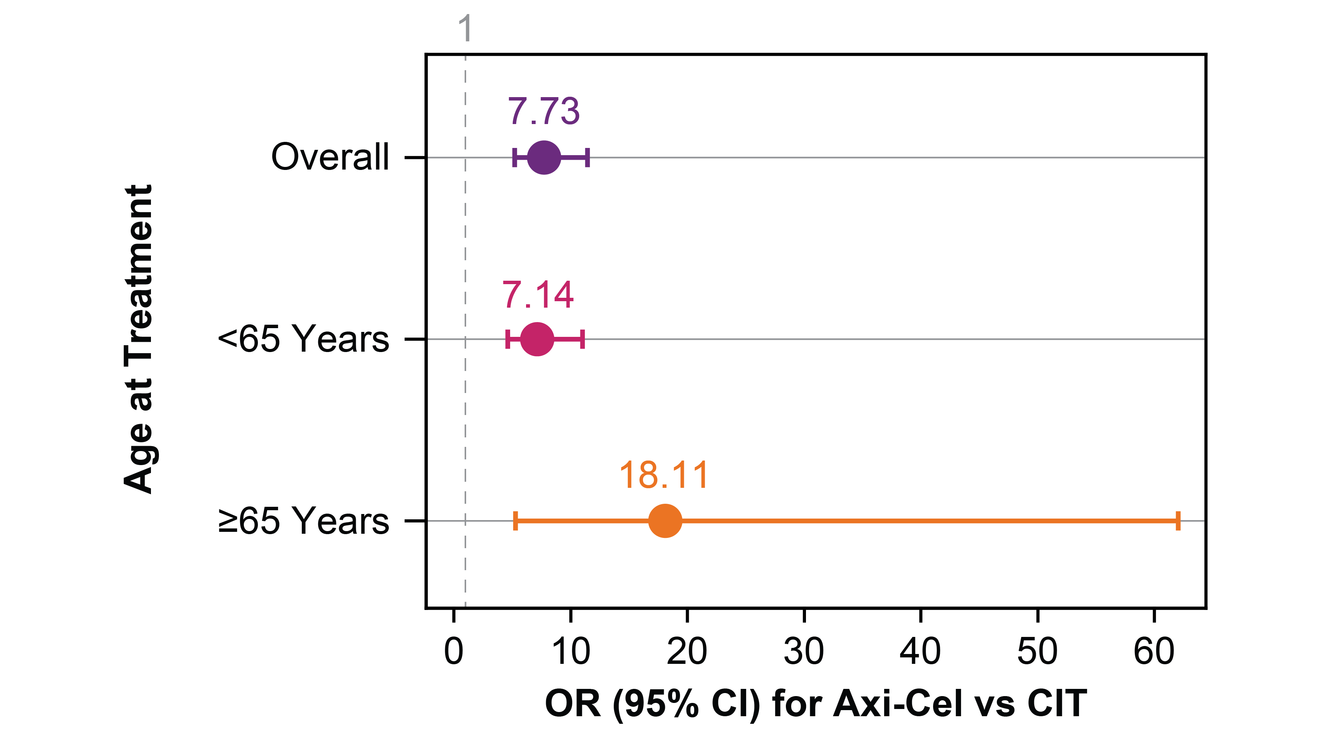
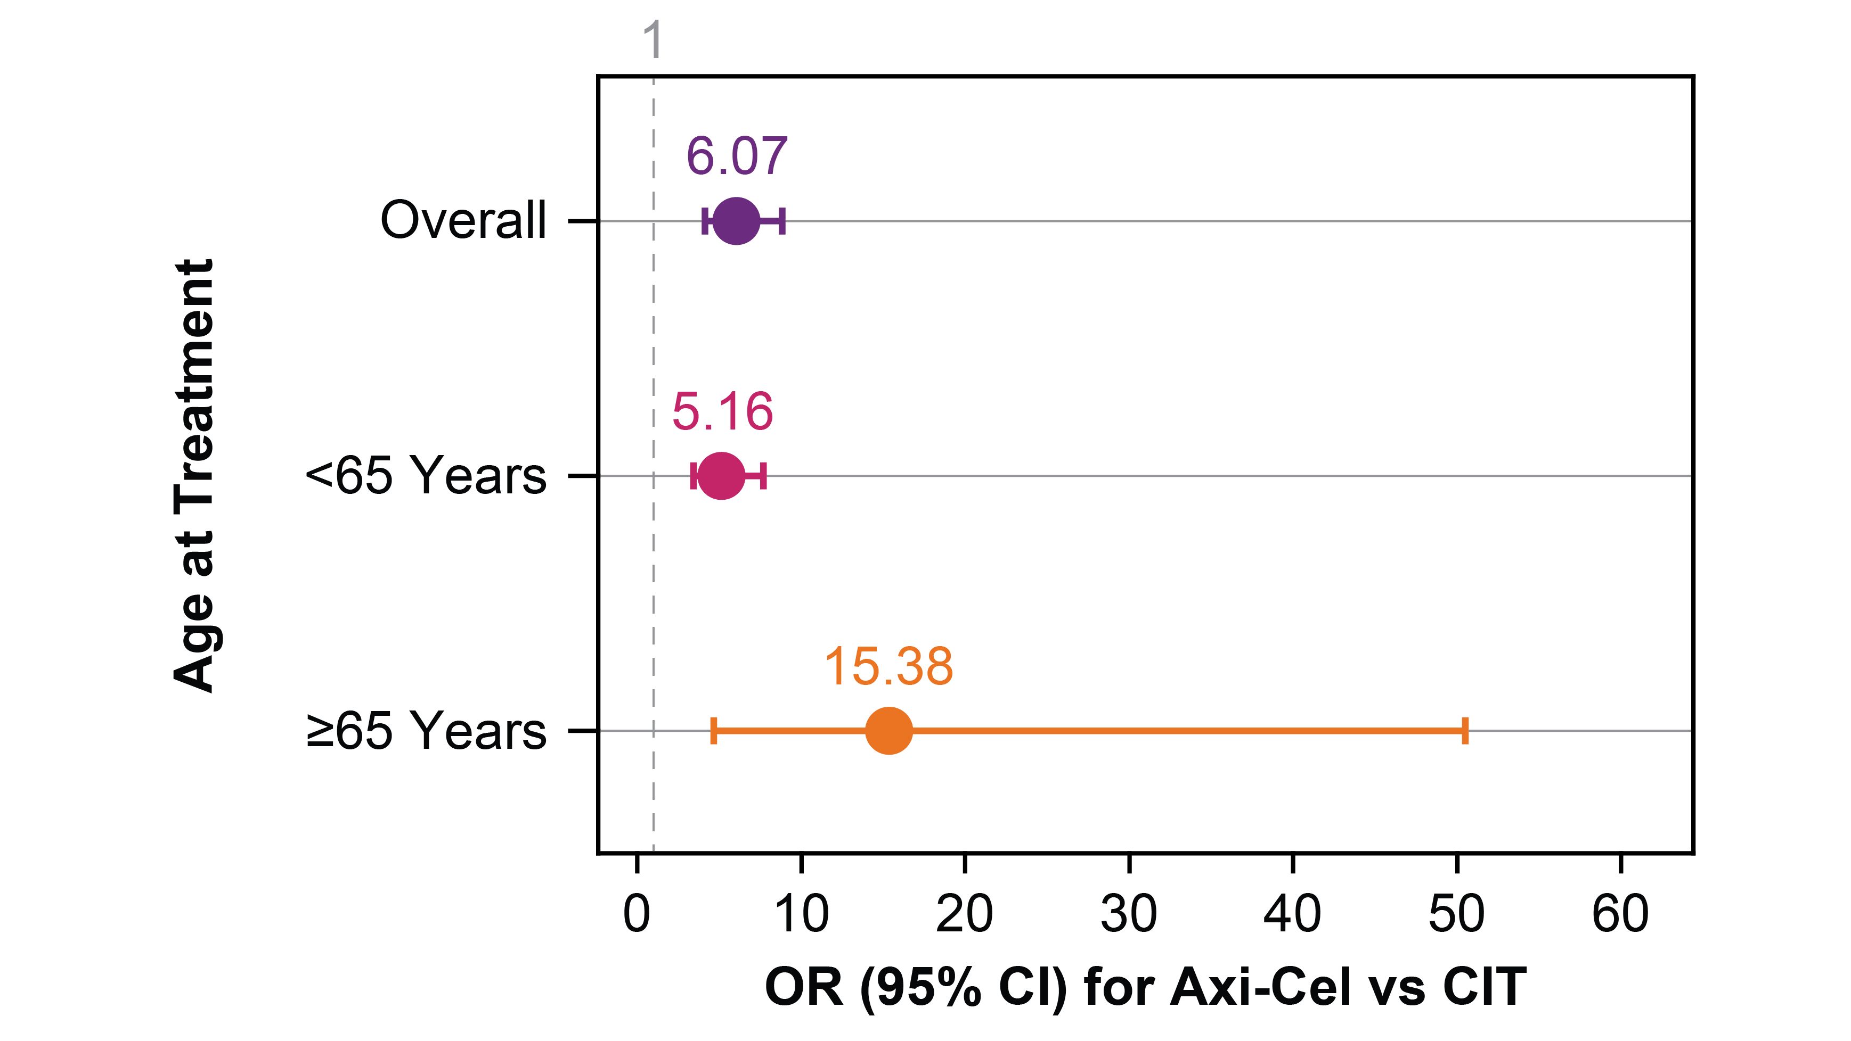
Odds Ratios of ORR and CR Rate Propensity Score Matching
Adjusted Odds Ratios for ORR
Adjusted Odds Ratios for CR Rate
Patients who received axi-cel had significantly higher ORR (OR, 7.73; 95% CI, 5.21-11.45) and CR rate (OR, 6.07; 95% CI, 4.15-8.86) compared with CIT after adjusting for prespecified key prognostic factorsª
Increased magnitude of benefit in response rates for axi-cel versus CIT was also observed among patients aged ≥65 years
ª To adjust for residual confounding, additional adjustments of covariates were made, based on a step-wise selection procedure, in the regression model. For ORR, patient sex was selected and adjusted for in the model (male vs female OR, 0.51; 95% CI, 0.31-0.84). For CR, no additional covariates were identified as requiring adjusting in the model.
Axi-cel, axicabtagene ciloleucel; CIT, chemoimmunotherapy; CR, complete response; OR, odds ratio; ORR, overall response rate.

Slide 9
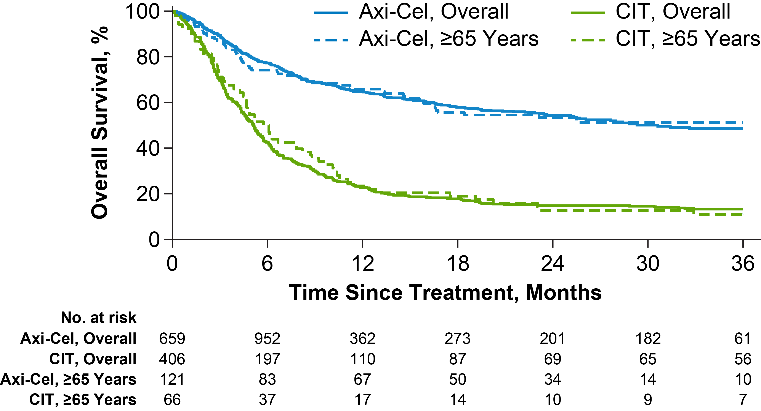
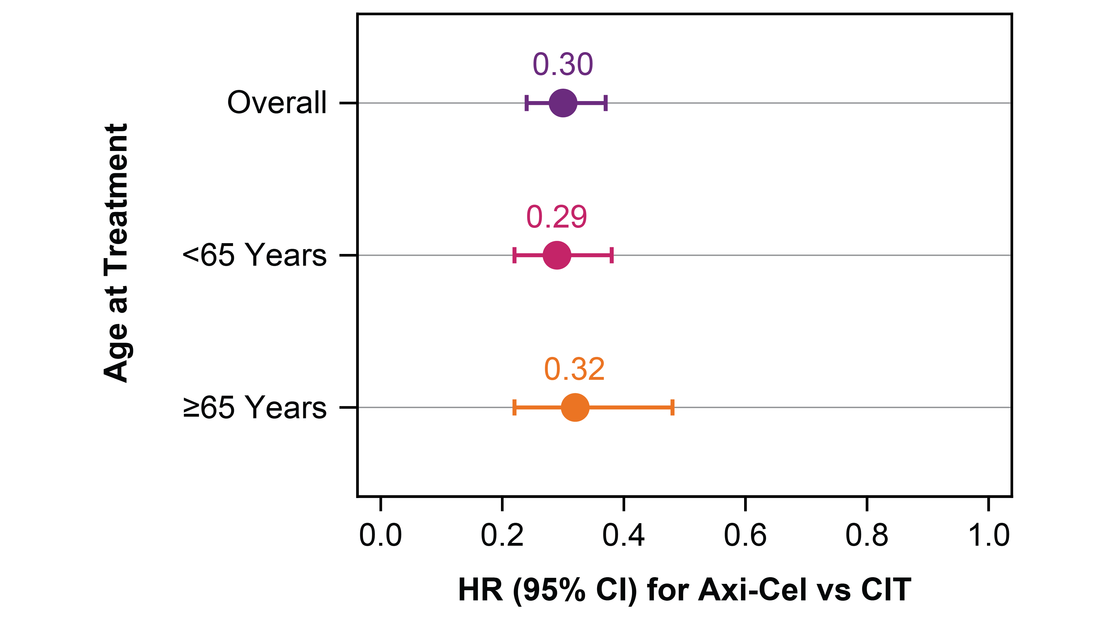
Overall Survival Propensity Score Matching
Adjusted OS
Adjusted Hazard Ratios for OS
Adjusted OS at 12 months was 65% (95% CI, 61-68) for axi-cel patients versus 23% (95% CI, 18-27) for patients receiving CIT
Compared with CIT, axi-cel was associated with longer OS (HR, 0.30; 95% CI, 0.24-0.37) among all patients, those aged ≥65 years (HR, 0.32; 95% CI, 0.22-0.48), and those <65 years (HR, 0.29; 95% CI, 0.22-0.38)
Adjusted OS analysis was based on a stratified Cox model^{1,2} and adjusted for: ECOG performance score (0-1 vs ≥2 vs unknown); disease stage at initial diagnosis (I or II vs III or IV vs unknown); number of prior lines of therapy (excluding ASCT; 2 vs ≥3); and refractory to all prior lines of therapy (yes vs no).
1. Chang IM, et al. J Chronic Dis. 1982;35:669-674. 2. Gail MH and Byar DP. Biom J. 1986;28:587-599.
ASCT, autologous stem cell transplantation; axi-cel, axicabtagene ciloleucel; CIT, chemoimmunotherapy; ECOG, Eastern Cooperative Oncology Group; HR, hazard ratio; OS, overall survival.

Slide 10
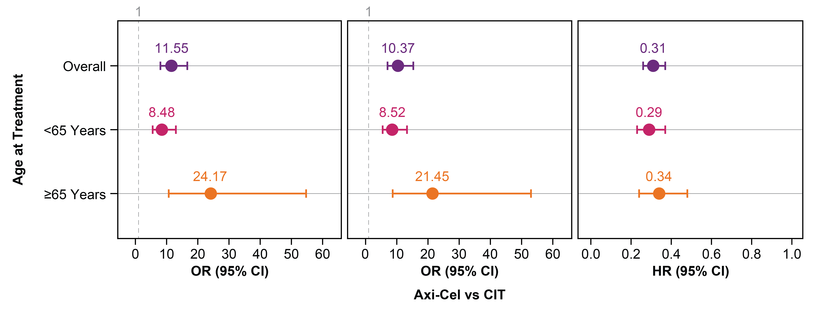
Unmatched Full Analysis Population Multivariable Sensitivity Analysis
ORR
CR Rate
OS
A sensitivity analysis based on conventional multivariable logistic and Cox regressions in the unmatched full analysis population showed consistent results
Axi-cel, axicabtagene ciloleucel; CIT, chemoimmunotherapy; CR, complete response; HR, hazard ratio; OR, odds ratio; ORR, overall response rate; OS, overall survival.

Slide 11
Conclusions
This is the first study to estimate the real-world effectiveness of axi-cel compared with CIT in patients with R/R LBCL after ≥2 lines of therapy
Axi-cel provides clinically meaningful benefits to patients of all ages in real-world settings, whereby overall responses and CR rates were higher, and OS was longer among axi‐cel versus CIT recipients
Notably, a larger relative benefit in response rates over CIT was observed among elderly patients (≥65 years) who received axi-cel
These findings further support the broad use of axi-cel in the elderly population

Slide 12
Acknowledgments
The patients, families, friends, and caregivers
The study investigators, coordinators, and healthcare staff at each study site
Medical writing support was provided by Nexus Global Group Science, funded by Kite, a Gilead Company
On behalf of the CIBMTR® Cellular Immunotherapy for Cancer Working Committee. CIBMTR® is a research collaboration between National Marrow Donor Program®/ Be The Match® and the Medical College of Wisconsin, and operates the Cellular Immunotherapy Data Resource (CIDR); research funding is received from the National Cancer Institute (U24 CA233032)
Copies of this presentation obtained through Quick Response Code are for personal use only and may not be reproduced without permission from ASH® or the author of this presentation.

