Slide 1
Association of Metabolic Tumor Volume and Clinical Outcomes in Second-Line Relapsed/Refractory Large B-Cell Lymphoma Following Axicabtagene Ciloleucel Versus Standard-of-Care Therapy in ZUMA-7
Frederick L. Locke, MD¹; Olalekan O. Oluwole, MBBS, MPH²; John Kuruvilla, MD, FRCPC³; Catherine Thieblemont, MD, PhD⁴; Franck Morschhauser, MD, PhD⁵; Gilles Salles, MD, PhD⁶; Steven P. Rowe, MD, PhD⁷; Saran Vardhanabhuti, PhD⁸; Simone Filosto, PhD⁸; Christina To, MD⁸; Paul Cheng, MD, PhD^{8,†}; Marco Schupp, MD⁸; Ronald Korn, MD, PhD⁹; and Marie José Kersten, MD, PhD¹⁰
¹Moffitt Cancer Center, Tampa, FL, USA; ²Vanderbilt University Cancer Center, Nashville, TN, USA; ³Princess Margaret Cancer Centre, University of Toronto, Toronto, Canada; ⁴University of Paris, Hôpital Saint-Louis, Hemato-Oncology, DMU DHI, Paris, France; ⁵University of Lille, Centre Hospitalier Universitaire de Lille, Lille, France; ⁶Memorial Sloan Kettering Cancer Center, New York, NY, USA; ⁷Johns Hopkins School of Medicine, Baltimore, MD, USA; ⁸Kite, a Gilead Company, Santa Monica, CA, USA; ⁹Imaging Endpoints, Scottsdale, AZ, USA; and ¹⁰Amsterdam UMC, University of Amsterdam, Amsterdam, Netherlands, on behalf of HOVON/LLPC

Slide 2
Background
Axi-cel is a CD19-directed genetically modified autologous T-cell immunotherapy with a CD28 co-stimulatory domain that provides rapid and strong expansion and reprograms T cells to trigger target-specific cytotoxicity of cancer cells^{1,2}
In the Phase 3 randomized ZUMA-7 (NCT03391466) study, axi-cel showed superiority to SOC across common prognostic subgroups, including high TB, as calculated by SPD, and elevated LDH³
SPD is based on ≤6 target lesions only^{3,4} and does not account for non-measured lesions or metabolic activity
TB can also be measured by MTV using FDG PET-CT scans
Though it is not a standardized clinical assessment, MTV has previously been shown to correlate with clinical outcomes of CAR T-cell therapy in 3L R/R LBCL^{5,6}
Here, we present clinical outcomes for patients in ZUMA-7 by MTV

Slide 3
ZUMA-7 Study Schema and Endpoints: Axi-Cel Versus SOC as Second-Line Therapy in Patients With R/R LBCL
R/R LBCL
77 sites
Key Eligibility:
Aged ≥18 y
LBCL¹
R/R ≤12 mo of 1L therapyª
Intended to proceed to HDT‐ASCT
Stratification:
Response to 1L therapy
sAAIPI
Optional Steroid-Only Bridging (No Chemotherapy)
Initial Disease Assessment (Day 50)
Day 100 Assessment
Day 150 Assessment
LTFU Assessment
Axi-Cel (N=180)
Conditioning Chemotherapy + Axi‐Cel^{b}
Primary Endpoint
EFS^{d} by blinded central review
Key Secondary Endpoints
ORR
OS
Secondary Endpoints
PFS
Safety
PROs
No Protocol-Specified Crossover
1:1 Randomization
SOC (N=179)
Responders
(CR or PR)
Proceed to HDT‐ASCT
Cycle 1
Cycle 2
Cycle 3
(Optional)
Investigator-Selected Platinum‐Based Chemoimmunotherapy^{c}
Nonresponders
Additional Treatment Off Protocol

Slide 4
Measurement of MTV
MTV was obtained from the attenuation-corrected whole-body FDG PET scans performed at screening
Whole tumor volumes of interest were placed on tumors using a predefined, semiautomated approachª
Subsequent radiology-defined adjustments of volumes of interest placement were conducted
MTV was calculated as the number of voxels with SUV measurements between 41%-100% of tumor SUV_{max} and reported as MTV_{total} (mL) per patient
Associations between MTV and baseline characteristics or clinical outcomes were assessed descriptively (P<.05 was considered significant)

Slide 5
Baseline MTV by Treatment Arm and Characteristics
Treatment Arm or Characteristic | n/Nª | Median MTV (range), mL
Treatment arm
Axi-cel | 176/180 | 228.10 (2.3-16,669.3)
SOC | 165/179 | 231.90 (0.04-2811.2)
Age
<65 years | 236/250 | 255.21 (0.04-16,669.3)
≥65 years | 105/109 | 176.71 (6.8-4101.8)
Molecular subgroup, per central laboratory
GCB | 203/208 | 228.66 (3.5-16,669.3)
Non-GCB | 53/56 | 242.60 (6.9-5488.5)
Disease type, per central laboratory
HGBL | 54/57 | 307.71 (8.5-6823.5)
Non-HGBL | 252/256 | 228.03 (0.04-16,669.3)
LDH^{b}
Elevated | 185/195 | 371.17 (2.3-16,669.3)
Normal | 156/164 | 123.92 (0.04-3712.8)
Treatment Arm or Characteristic | n/Nª | Median MTV (range), mL
Response to 1L therapy at randomization
Primary refractory | 252/265 | 236.88 (0.04-16,669.3)
Relapse ≤12 mo after initiation or completion of 1L therapy | 88/92 | 214.85 (3.6-5317.7)
CD19 H-score^{c}
≤median | 150/152 | 241.31 (0.04-16,669.3)
>median | 146/151 | 229.72 (2.3-13,527.0)
CD19 IHC^{d}
Positive | 271/278 | 237.37 (0.04-13,527.0)
Negative | 25/25 | 248.89 (3.6-16,669.3)
Overall median MTV was 230.24 mL (range: 0.04-16,669.3)
Median MTV was similar across treatment arms

Slide 6
Baseline MTV by Treatment Arm and Characteristics
Treatment Arm or Characteristic | n/Nª | Median MTV (range), mL
Treatment arm
Axi-cel | 176/180 | 228.10 (2.3-16,669.3)
SOC | 165/179 | 231.90 (0.04-2811.2)
Age
<65 years | 236/250 | 255.21 (0.04-16,669.3)
≥65 years | 105/109 | 176.71 (6.8-4101.8)
Molecular subgroup, per central laboratory
GCB | 203/208 | 228.66 (3.5-16,669.3)
Non-GCB | 53/56 | 242.60 (6.9-5488.5)
Disease type, per central laboratory
HGBL | 54/57 | 307.71 (8.5-6823.5)
Non-HGBL | 252/256 | 228.03 (0.04-16,669.3)
LDH^{b}
Elevated | 185/195 | 371.17 (2.3-16,669.3)
Normal | 156/164 | 123.92 (0.04-3712.8)
Treatment Arm or Characteristic | n/Nª | Median MTV (range), mL
Response to 1L therapy at randomization
Primary refractory | 252/265 | 236.88 (0.04-16,669.3)
Relapse ≤12 mo after initiation or completion of 1L therapy | 88/92 | 214.85 (3.6-5317.7)
CD19 H-score^{c}
≤median | 150/152 | 241.31 (0.04-16,669.3)
>median | 146/151 | 229.72 (2.3-13,527.0)
CD19 IHC^{d}
Positive | 271/278 | 237.37 (0.04-13,527.0)
Negative | 25/25 | 248.89 (3.6-16,669.3)
Overall median MTV was 230.24 mL (range: 0.04-16,669.3)
Median MTV was similar across treatment arms

Slide 7
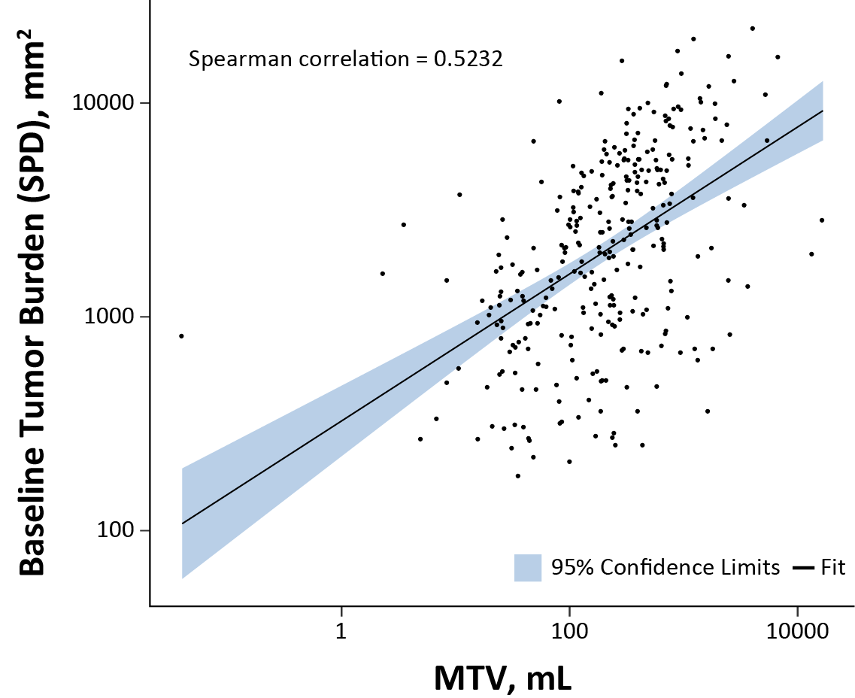
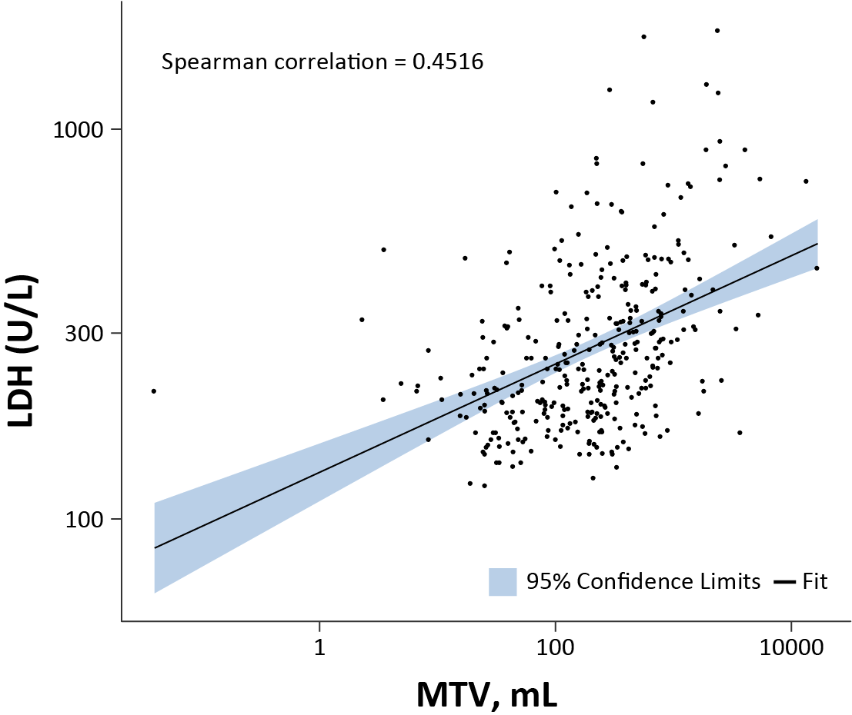
Correlation of MTV With SPD and LDH in Both Treatment Arms
SPD
LDH
MTV was positively correlated with SPD and LDH

Slide 8
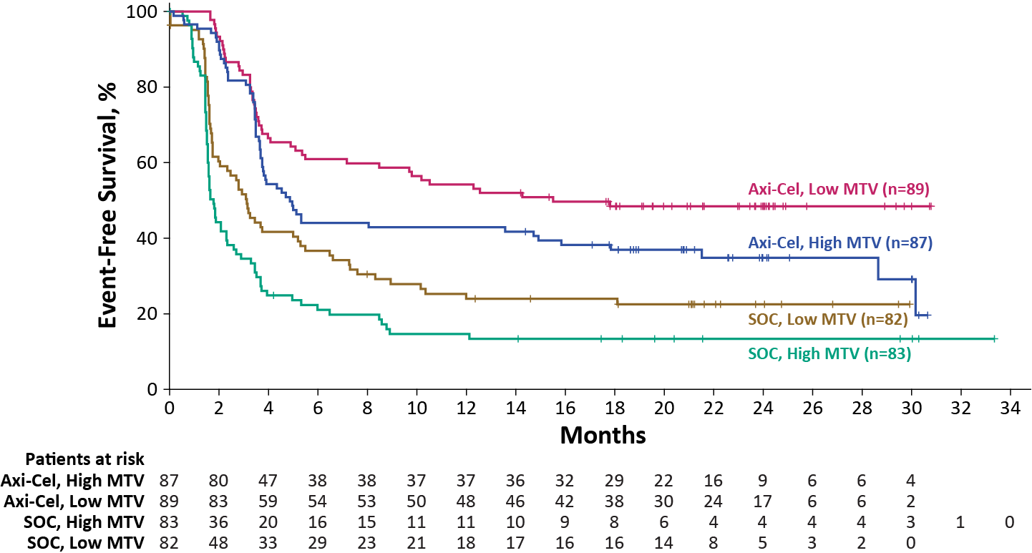
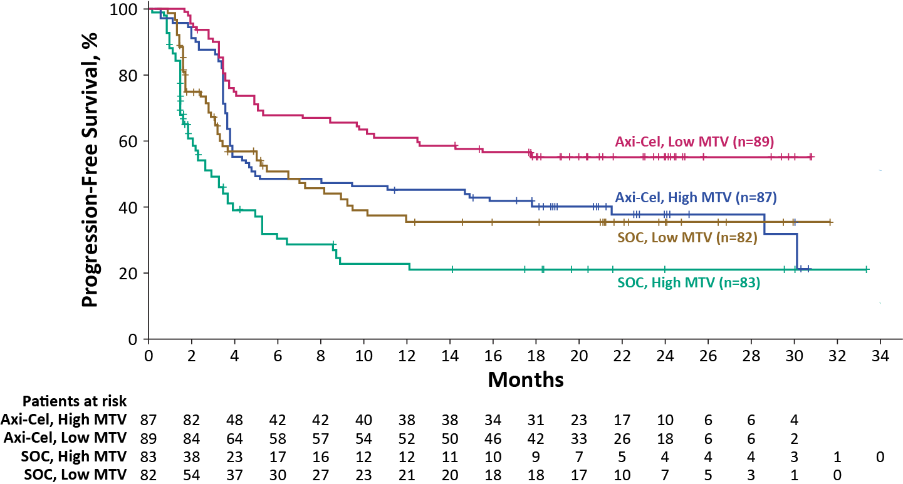
EFS and PFS by MTV and Treatment Arm
EFS
PFS
 | HR (95% CI)
High MTV (Axi-Cel vs SOC) | 0.417 (0.293-0.592
Low MTV (Axi-Cel vs SOC) | 0.423 (0.288-0.620)
Axi-Cel MTV (High vs Low) | 1.441 (0.978-2.124)
SOC MTV (High vs Low) | 1.486 (1.055-2.093)
 | HR (95% CI)
High MTV (Axi-Cel vs SOC) | 0.523 (0.357-0.765)
Low MTV (Axi-Cel vs SOC) | 0.504 (0.328-0.776)
Axi-Cel MTV (High vs Low) | 1.644 (1.090-2.480)
SOC MTV (High vs Low) | 1.635 (1.098-2.433)
Axi-cel EFS and PFS were superior to SOC for both low (≤median) and high (>median) MTV
Axi-cel EFS trended shorter in patients with high MTV and EFS was shorter in SOC patients with high MTV
PFS was shorter in both axi-cel and SOC patients with high MTV compared with low MTV

Slide 9
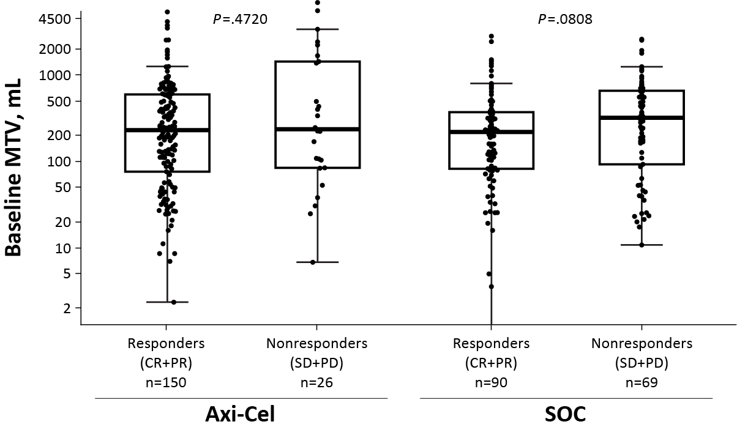
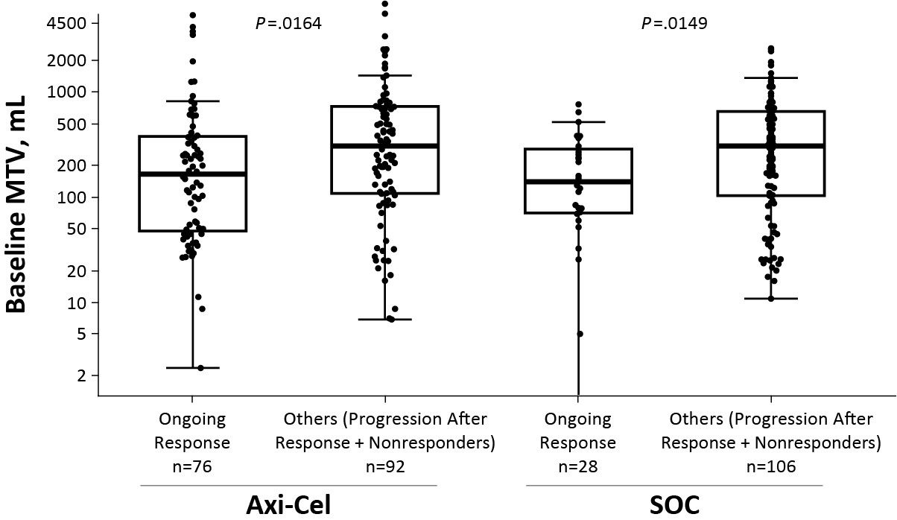
MTV by Response and Treatment Arm
Responders vs Nonresponders
Ongoing Response vs Others
In the axi-cel arm, median MTV was similar between responders (CR + PR) and nonresponders (SD + PD)
MTV was lower in patients treated with axi-cel who were in ongoing response compared with others (progression after response + nonresponders)
MTV trended lower in patients with CR compared with others (PR, SD, and PD; data not shown)
Notably, by logistic regression, a negative association was observed between CR and MTV in both axi-cel and SOC arms

Slide 10
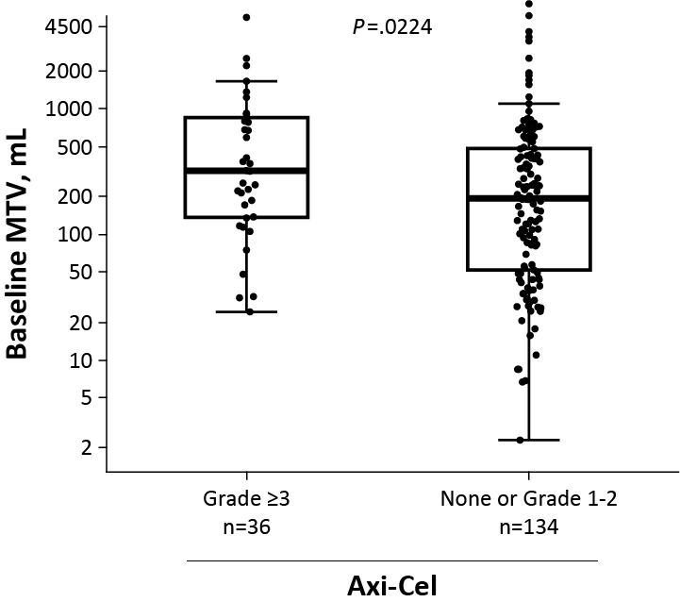
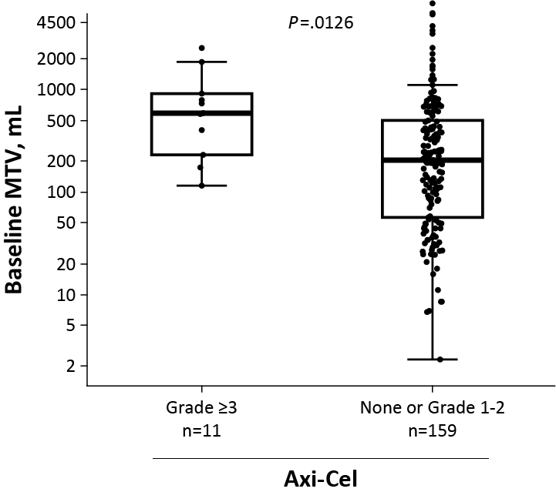
Association of MTV With Toxicity in the Axi-Cel Arm
Neurologic Events
CRS
In the axi-cel arm, median MTV was higher in patients who experienced Grade ≥3 neurologic events or CRS compared with patients who experienced Grade 1-2 or no neurologic events or CRS, respectively
No associations of MTV and safety were observed for the SOC arm

Slide 11
Conclusions
To our knowledge, this analysis is the first to examine the relation between MTV and clinical outcome in a large, randomized, prospective R/R LBCL study of CAR T-cell therapy
Similar to previous analysis with SPD and LDH-based subgroups,³ axi-cel was superior to SOC for both high and low MTV groups
While TB per SPD did not seem to impact axi-cel outcomes in ZUMA-7,³ low MTV was associated with improved outcomes with axi-cel versus high MTV, and rates of Grade ≥3 neurologic events and CRS were associated with higher MTV
These findings suggest that MTV may be a better prognostic marker than SPD

Slide 12
Acknowledgments
The patients, families, friends, and caregivers
The entire ZUMA‑7 study team of investigators, coordinators, and health care staff at each study site
Marc Gregory of Imaging Endpoints for assistance with FDG PET-CT scans
Medical writing support was provided by Jennifer Yang, PhD, of Nexus Global Group Science LLC, funded by Kite, a Gilead Company
†Current affiliation: US Department of Veterans Affairs; Dr. Cheng was an employee of Kite when the studies reported here were conducted
All employees of Kite, a Gilead Company, involved over the course of the study for their contributions
ZUMA-7 Global Phase 3 Clinical Trial Sites
Copies of this presentation obtained through Quick Response Code are for personal use only and may not be reproduced without permission from the author of this presentation.

