Slide 1
Outcomes of Subsequent Anti-Lymphoma Therapies in Patients With Large B-Cell Lymphoma Treated With Axicabtagene Ciloleucel or Standard of Care in the Second‐Line ZUMA-7 Study
Armin Ghobadi, MD¹; Javier Munoz, MD, MS, MBA, FACP²; Jason R. Westin, MD, MS, FACP³; Frederick L. Locke, MD⁴; David B. Miklos, MD, PhD⁵; Aaron P. Rapoport, MD⁶; Miguel-Angel Perales, MD⁷; Patrick M. Reagan, MD⁸;
Joseph McGuirk, DO⁹; Caron A. Jacobson, MD, MMSc¹⁰; Marie José Kersten, MD, PhD¹¹; Irit Avivi, MD¹²;
Andrew Peng, MS¹³; Marco Schupp, MD¹³; Christina To, MD¹³; and Olalekan Oluwole, MBBS, MPH¹⁴
¹Washington University School of Medicine, St Louis, MO, USA; ²Banner MD Anderson Cancer Center, Gilbert, AZ, USA; ³The University of Texas MD Anderson Cancer Center, Houston, TX, USA; ⁴Moffitt Cancer Center, Tampa, FL, USA; ⁵Stanford University School of Medicine, Stanford, CA, USA; ⁶University of Maryland School of Medicine and Marlene and Stewart Greenebaum Comprehensive Cancer Center, Baltimore, MD, USA; ⁷Memorial Sloan Kettering Cancer Center, New York, NY, USA; ⁸University of Rochester School of Medicine, Rochester, NY, USA; ⁹University of Kansas Cancer Center, Kansas City, KS, USA; ¹⁰Dana-Farber Cancer Institute, Boston, MA, USA; ¹¹Amsterdam UMC, University of Amsterdam, Amsterdam, The Netherlands, on behalf of HOVON/LLPC; ¹²Tel Aviv Sourasky Medical Center and Sackler Faculty of Medicine, Tel Aviv University, Tel Aviv, Israel; ¹³Kite, a Gilead Company, Santa Monica, CA, USA; and ¹⁴Vanderbilt University Cancer Center, Nashville, TN, USA

Slide 2
Background
Axi-cel is a CD19-directed genetically modified autologous T-cell immunotherapy with a CD28 co-stimulatory domain that provides rapid and strong expansion and reprograms T cells to trigger target-specific cytotoxicity of cancer cells^{1,2}
Axi-cel has demonstrated strong and durable efficacy in adult patients with R/R LBCL after ≥2 lines of systemic therapy^{3,4}
In pivotal Cohorts 1+2 of ZUMA-1, the ORR was 83% (CR rate: 58%)³ and 5-year OS rate was 43%⁴
In the ZUMA-7 axi-cel arm, the ORR was 83% (CR rate: 65%) and estimated 2-year OS rate, evaluated as an interim analysis, was 61%⁵
Axi-cel significantly improved outcomes versus 2L SOC (EFS HR, 0.398, P<.0001) in ZUMA-7⁵
Thus, CAR T-cell therapy has been proposed as the new SOC for 2L treatment for eligible patients⁶
Nonetheless, patients may require additional therapy and the question of optimal management after 2L therapy remains
Here, we present outcomes for patients who received subsequent anti-lymphoma treatment in ZUMA-7

Slide 3
ZUMA-7 Study Schema and Endpoints: Axi-Cel Versus SOC as Second-Line Therapy in Patients With R/R LBCL
R/R LBCL
77 sites
Key Eligibility:
Aged ≥18 y
LBCL¹
R/R ≤12 mo of 1L therapyª
Intended to proceed to HDT‐ASCT
Stratification:
Response to 1L therapy
sAAIPI
Optional Steroid-Only Bridging (No Chemotherapy)
Initial Disease Assessment (Day 50)
Day 100 Assessment
Day 150 Assessment
LTFU Assessment
Axi-Cel (N=180)
Conditioning Chemotherapy + Axi‐Cel^{b}
Primary Endpoint
EFS^{d} by blinded central review
Key Secondary Endpoints
ORR
OS
Secondary Endpoints
PFS
Safety
PROs
No Protocol-Specified Crossover
1:1 Randomization
SOC (N=179)
Responders
(CR or PR)
Proceed to HDT‐ASCT
Cycle 1
Cycle 2
Cycle 3
(Optional)
Investigator-Selected Platinum‐Based Chemoimmunotherapy^{c}
Nonresponders
Additional Treatment Off Protocol

Slide 4
Subsequent Therapy in ZUMA-7
For this analysis, subsequent 3L therapy was classified as
For this ITT analysis, subsequent therapy was defined as any new, off-protocol lymphoma therapy, regardless of whether randomized protocol therapy was given
Patients who did not meet the criteria for a PFS event were censored at 4L treatment initiation, if any, or last known alive date
Patients who received subsequent SCT while in a response from 3L axi-cel retreatment were censored at the time of SCT
Kaplan-Meier estimates for PFS and OS were calculated from 3L treatment initiation
Axi-Cel Arm
Chemotherapy
SOC Arm
Cellular immunotherapy
Cellular immunotherapy
(axi-cel retreatment on protocol for patients who initially responded to axi-cel)
Non-cellular immunotherapy
Other

Slide 5
Overview of Subsequent 3L+ Therapy
Enrolled (N=359)
Axi-Cel Arm (n=180)
SOC Arm (n=179)
Received Axi-Cel
n=170
No Axi-Cel
n=10
No SOC
n=11
Received SOC
n=168
Received SCT (n=62)
Did not receive SCT (n=106)
Received Subsequent 3L Therapy
n=84
Received Subsequent 3L Therapy
n=127
3L Otherª
n=16
3L Chemotherapy
n=60
3L Cellular Immunotherapy
n=8
3L Cellular Immunotherapy^{b}
n=68
No 3L Cellular Immunotherapy
n=59
SCT
n=10
No SCT
n=50
SCT
n=6
No SCT
n=2
9 ASCT
1 alloSCT
1 ASCT
5 alloSCT

Slide 6
Overview of Subsequent 3L+ Therapy
Enrolled (N=359)
Axi-Cel Arm (n=180)
SOC Arm (n=179)
Received Axi-Cel
n=170
No Axi-Cel
n=10
No SOC
n=11
Received SOC
n=168
Received SCT (n=62)
Did not receive SCT (n=106)
47%
Received Subsequent 3L Therapy
n=84
Received Subsequent 3L Therapy
n=127
71%
3L Otherª
n=16
3L Chemotherapy
n=60
3L Cellular Immunotherapy
n=8
3L Cellular Immunotherapy^{b}
n=68
No 3L Cellular Immunotherapy
n=59
SCT
n=10
No SCT
n=50
SCT
n=6
No SCT
n=2
9 ASCT
1 alloSCT
1 ASCT
5 alloSCT

Slide 7
Overview of Subsequent 3L+ Therapy
Enrolled (N=359)
Axi-Cel Arm (n=180)
SOC Arm (n=179)
Received Axi-Cel
n=170
No Axi-Cel
n=10
No SOC
n=11
Received SOC
n=168
Received SCT (n=62)
Did not receive SCT (n=106)
Received Subsequent 3L Therapy
n=84
Median time to 3L therapy: 4.4 mo
Received Subsequent 3L Therapy
n=127
Median time to 3L therapy: 2.8 mo
3L Otherª
n=16
3L Chemotherapy
n=60
3L Cellular Immunotherapy
n=8
3L Cellular Immunotherapy^{b}
n=68
No 3L Cellular Immunotherapy
n=59
SCT
n=10
No SCT
n=50
SCT
n=6
No SCT
n=2
9 ASCT
1 alloSCT
1 ASCT
5 alloSCT

Slide 8
Overview of Subsequent 3L+ Therapy
Enrolled (N=359)
Axi-Cel Arm (n=180)
SOC Arm (n=179)
Received Axi-Cel
n=170
No Axi-Cel
n=10
No SOC
n=11
Received SOC
n=168
Received SCT (n=62)
Did not receive SCT (n=106)
6 (3%) patients did not receive 3L therapy after disease progression
8 (4%) patients did not receive 3L therapy after disease progression
Received Subsequent 3L Therapy
n=84
Received Subsequent 3L Therapy
n=127
3L Otherª
n=16
3L Chemotherapy
n=60
3L Cellular Immunotherapy
n=8
3L Cellular Immunotherapy^{b}
n=68
No 3L Cellular Immunotherapy
n=59
SCT
n=10
No SCT
n=50
SCT
n=6
No SCT
n=2
9 ASCT
1 alloSCT
1 ASCT
5 alloSCT

Slide 9
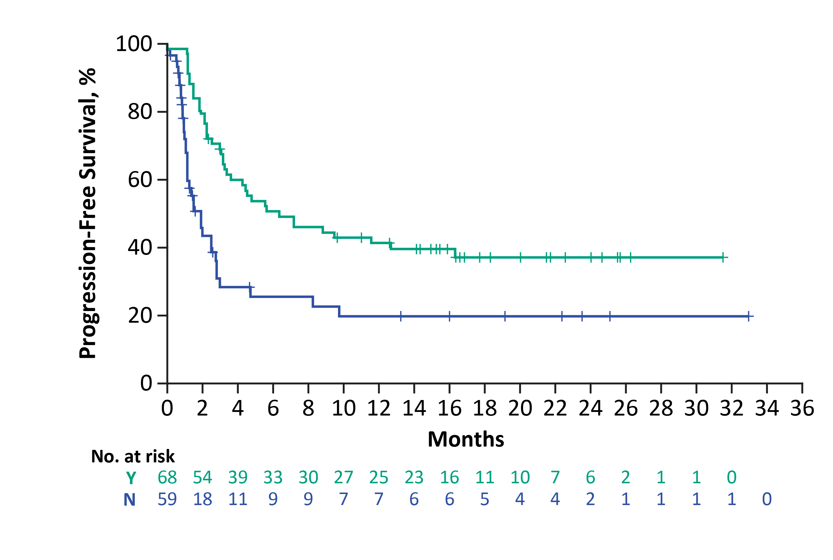
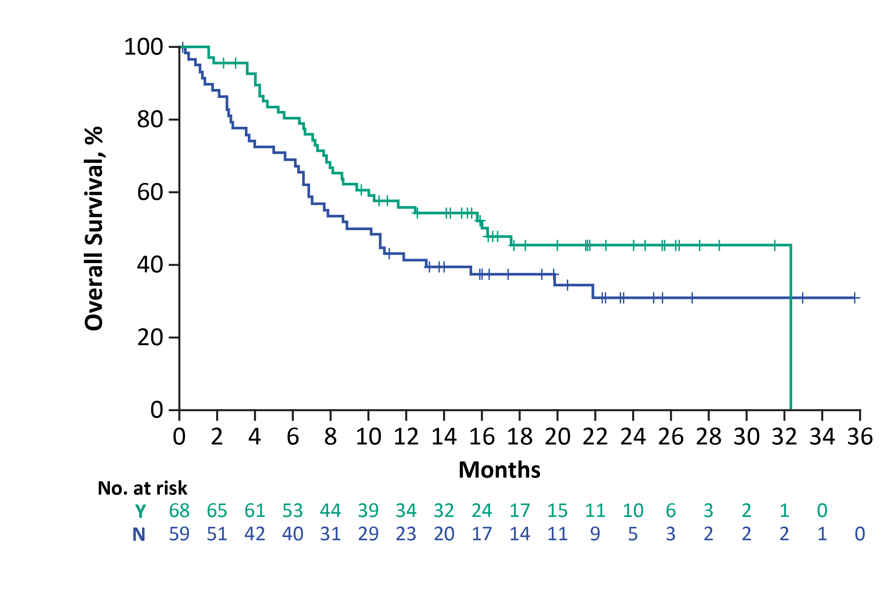
PFS and OS by 3L Cellular Immunotherapy in the SOC Arm Since 3L Treatment Initiation
PFS
OS
3L Cellular Immunotherapy | Median PFS (95% CI, mo)
Yes (n=68) | 6.3 (3.4-16.3)
No (n=59) | 1.9 (1.1-2.7)
3L Cellular Immunotherapy | Median OS (95% CI, mo)
Yes (n=68) | 16.3 (8.7-NE)
No (n=59) | 9.5 (6.6-15.4)
56%
12-Month
41%
12-Month
41%
20%
Median follow-up since 3L treatment initiation: 16.6 mo
Median follow-up since 3L treatment initiation: 20.0 mo
In the SOC arm, patients who received 3L cellular immunotherapy (n=68) had a 57% ORR (34% CR rate)

Slide 10
Outcomes for Patients Who Received 3L Cellular Immunotherapy in the SOC Arm Versus 2L Axi-cel
No formal comparative statistical analyses were conducted
2L Axi-Cel¹
Median PFS, months: 14.7 (5.4-NE)
Median OS, months: NR (28.3-NE)
ORR, %: 83 (77-88)
CR, %: 65 (58-72)
3L Cellular Immunotherapy in the SOC Armª
Median PFS, months: 6.3 (3.4-16.3)
Median OS, months: 16.3 (8.7-NE)
ORR, %: 57 (45-69)
CR, %: 34 (23-46)

Slide 11
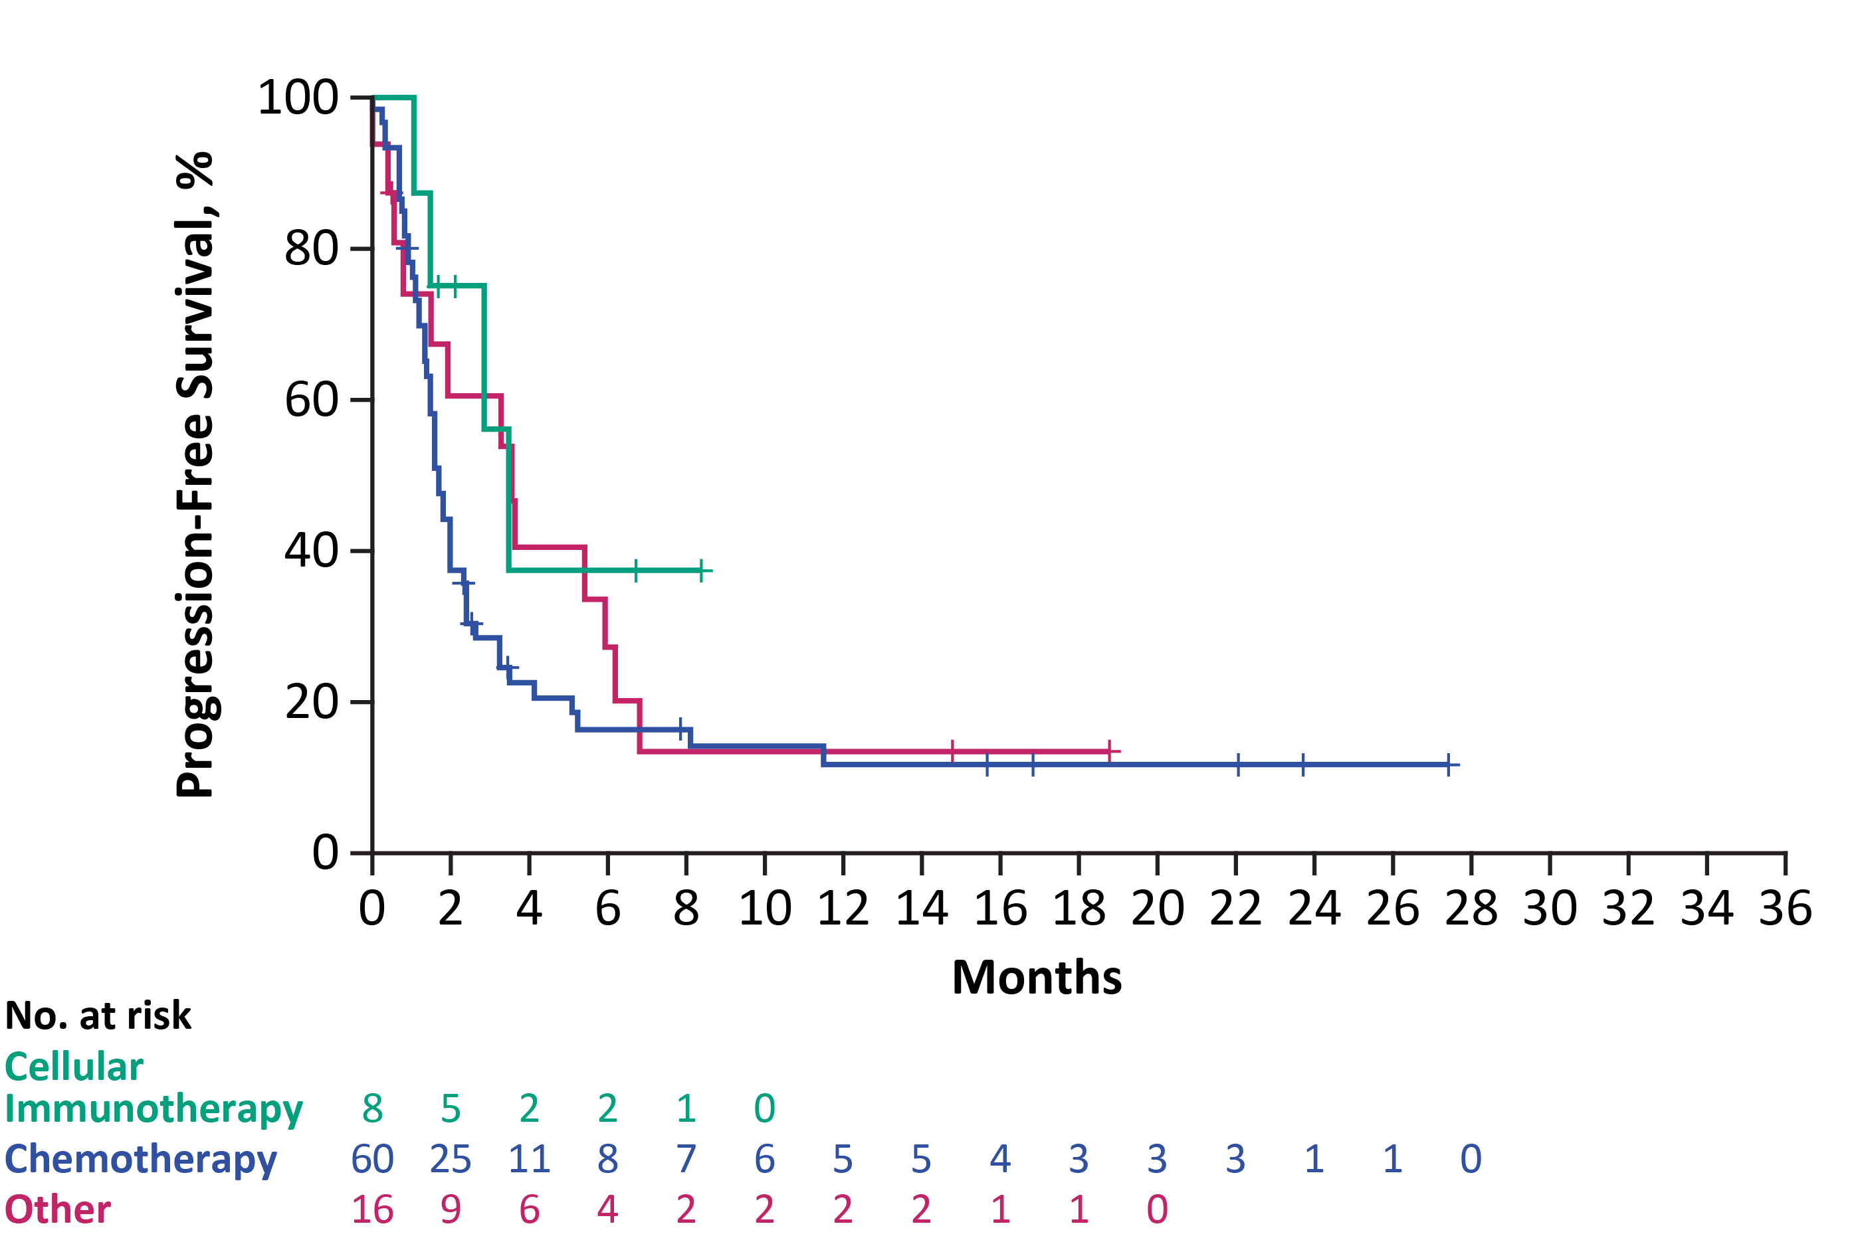
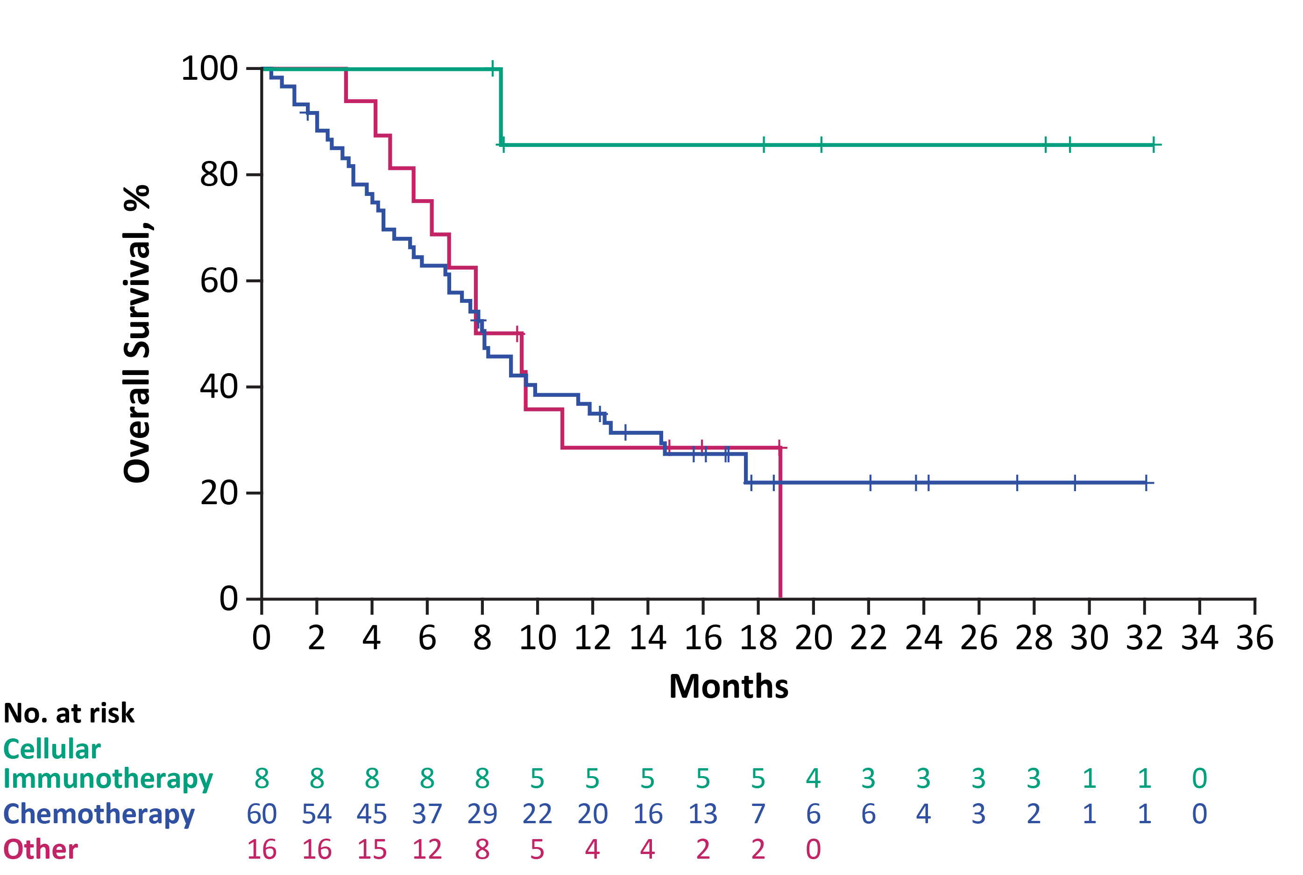
PFS and OS by 3L Treatment in the Axi-Cel Arm Since 3L Treatment Initiation
PFS
OS
 | Median PFS (95% CI, mo)
Cellular Immunotherapy (n=8) | 3.5 (1.1-NE)
Chemotherapy (n=60) | 1.7 (1.4-2.0)
Other (n=16) | 3.5 (0.8-5.9)
12-Month
86%
 | Median OS (95% CI, mo)
Cellular Immunotherapy (n=8) | NR (8.7-NE)
Chemotherapy (n=60) | 8.1 (5.8-11.5)
Other (n=16) | 8.6 (5.5-NE)
35%
12-Month
Median follow-up since 3L treatment initiation: 15.7 mo
29%
13%
Median follow-up since 3L treatment initiation: 18.6 mo
12%
Patients who received 3L chemotherapy (n=60) had a 25% ORR (13% CR rate)
For 34 patients who received 3L chemotherapy after initial response to 2L axi-cel, overall median PFS was 1.7 months (95% CI, 1.4-2.4) and median OS was 8.1 months (95% CI, 6.8-11.9), with a 32% ORR (18% CR rate)

Slide 12
Of 60 Patients in the Axi-Cel Arm Who Received 3L Chemotherapy, 10 Received SCT in 3L+
Enrolled (N=359)
Axi-Cel Arm (n=180)
SOC Arm (n=179)
Received Axi-Cel
n=170
No Axi-Cel
n=10
No SOC
n=11
Received SOC
n=168
Received SCT (n=62)
Did not receive SCT (n=106)
Received Subsequent 3L Therapy
n=84
Received Subsequent 3L Therapy
n=127
3L Otherª
n=16
3L Chemotherapy
n=60
3L Cellular Immunotherapy
n=8
3L Cellular Immunotherapy^{b}
n=68
No 3L Cellular Immunotherapy
n=59
SCT
n=10
No SCT
n=50
SCT
n=6
No SCT
n=2
9 ASCT
1 alloSCT
1 ASCT
5 alloSCT

Slide 13
PFS and OS by SCT Following 3L Chemotherapy in the Axi-Cel Arm
Median PFS (95% CI): 11.5 (2.4-NE) months
Median OS (95% CI): 17.5 (2.4-NE) months
Of patients who received 3L chemotherapy, only 17% (10/60) received SCT
While results are descriptive due to low patient numbers, outcomes for patients who received SCT following 3L chemotherapy in the axi-cel arm appear improved compared with patients who did not receive SCT
It is unknown how many patients who received 3L therapy were intended for SCT
Median PFS (95% CI): 1.6 (1.2-1.8) months
Median OS (95% CI): 7.2 (4.8-9.1) months

Slide 14
Eight Patients in the Axi-Cel Arm Received 3L Cellular Immunotherapy
Enrolled (N=359)
Axi-Cel Arm (n=180)
SOC Arm (n=179)
Received Axi-Cel
n=170
No Axi-Cel
n=10
No SOC
n=11
Received SOC
n=168
Received SCT (n=62)
Did not receive SCT (n=106)
Received Subsequent 3L Therapy
n=84
Received Subsequent 3L Therapy
n=127
3L Otherª
n=16
3L Chemotherapy
n=60
3L Cellular Immunotherapy
n=8
3L Cellular Immunotherapy^{b}
n=68
No 3L Cellular Immunotherapy
n=59
SCT
n=10
No SCT
n=50
SCT
n=6
No SCT
n=2
9 ASCT
1 alloSCT
1 ASCT
5 alloSCT

Slide 15
Six Patients in the Axi-Cel Arm Received Subsequent SCT Following 3L Cellular Immunotherapy
3L Cellular Immunotherapy
n=8
5 patients remained in CR
1 patient who had a PR after axi-cel retreatment proceeded to alloSCT, with best response of CR, but relapsed 7.3 months after SCT
All 6 patients were alive at data cutoff date (median follow-up since 3L treatment initiation, 24.4 months)
1 ASCT
5 alloSCTª
Subsequent SCT
n=6
No SCT
n=2
Remained in CR
n=5
PR Following Axi-Cel Retreatment
n=1

Slide 16
Any-Line Cellular Immunotherapy OS Outcomes
SOC Arm
Lower hazard in patients who received any-line cellular immunotherapy versus those who did not receive any-line cellular immunotherapy
HR: 0.33 (95% CI, 0.16-0.68)
Axi-Cel Arm
Lower hazard in patients who received subsequent any-line cellular immunotherapy versus other
HR: 0.22 (95% CI, 0.07-0.66)
Higher hazard in patients who received any-line chemotherapy versus other
HR: 1.50 (95% CI, 0.58, 3.89)
Lower hazard in patients who received subsequent any-line SCT versus other
HR: 0.39 (95% CI, 0.17-0.88)

Slide 17
Conclusions
While results are descriptive and definitive conclusions cannot be made due to the small number of patients, these data suggest that
Outcomes for patients who received subsequent cellular therapy appeared better when cellular therapy is given earlier (2L versus 3L)
3L CAR T-cell therapy after initial response to axi-cel in 2L appears to be a viable option as patients were able to achieve clinically meaningful responses
Though a minority of patients who received 3L chemotherapy reached SCT, SCT can be considered for patients who are chemosensitive post 2L CAR T-cell therapy
These findings may help inform subsequent treatment choices that provide meaningful clinical benefit for patients after failure of 2L therapy for R/R LBCL

Slide 18
Acknowledgments
The patients, families, friends, and caregivers
ZUMA‑7 investigators, coordinators, and health care staff at each study site
Medical writing support was provided by Jennifer Yang, PhD, of Nexus Global Group Science LLC, funded by Kite, a Gilead Company
All employees of Kite, a Gilead Company, involved over the course of the study for their contributions
ZUMA-7 Global Phase 3 Clinical Trial Sites
Copies of this presentation obtained through Quick Response Code are for personal use only and may not be reproduced without permission from the author of this presentation.

