Slide 1
Primary Overall Survival Analysis of the Phase 3 Randomized ZUMA‑7 Study of Axicabtagene Ciloleucel Versus Standard-of-Care Therapy in Relapsed/Refractory Large B-Cell Lymphoma
Jason R. Westin, MD, MS, FACP¹; Olalekan O. Oluwole, MBBS, MPH²; Marie José Kersten MD, PhD³;
David B. Miklos, MD, PhD⁴; Miguel-Angel Perales, MD⁵; Armin Ghobadi, MD⁶; Aaron P. Rapoport, MD⁷;
Anna Sureda, MD, PhD⁸; Caron A. Jacobson, MD⁹; Umar Farooq, MD¹⁰; Tom van Meerten, MD, PhD¹¹;
Matthew L. Ulrickson, MD¹²; Mahmoud Elsawy, MD, MSc¹³; Lori A. Leslie, MD¹⁴; Sridhar Chaganti, MD¹⁵;
Michael Dickinson, MBBS, D Med Sci, FRACP, FRCPA¹⁶; Yin Yang, MD¹⁷; Marco Schupp, MD¹⁷; Christina To, MD¹⁷; and Frederick L. Locke, MD¹⁸
¹The University of Texas MD Anderson Cancer Center, Houston, TX, USA; ²Vanderbilt-Ingram Cancer Center, Nashville, TN, USA; ³Amsterdam UMC, University of Amsterdam, Cancer Center Amsterdam, Amsterdam, The Netherlands; ⁴Stanford University School of Medicine, Stanford, CA, USA; ⁵Memorial Sloan Kettering Cancer Center, New York, NY, USA; ⁶Washington University School of Medicine, St Louis, MO, USA; ⁷The Marlene and Stewart Greenebaum Cancer Center, University of Maryland School of Medicine, Baltimore, MD, USA; ⁸Servei d’Hematologia Clínica, Institut Català d'Oncologia-Hospitalet, Institut de Recerca Biomèdica de Bellvitge (IDIBELL), Universitat de Barcelona, Barcelona, Spain; ⁹Dana-Farber Cancer Institute, Boston, MA, USA; ¹⁰University of Iowa, Iowa City, IA, USA; ¹¹University Medical Center Groningen, Groningen, The Netherlands; ¹²Banner MD Anderson Cancer Center, Gilbert, AZ, USA; ¹³Division of Hematology and Hematologic Oncology, Department of Medicine, Dalhousie University and QEII Health Sciences Center, Halifax, Nova Scotia, Canada; ¹⁴John Theurer Cancer Center, Hackensack, NJ, USA; ¹⁵Centre for Clinical Haematology, University Hospitals Birmingham NHS Foundation Trust, Birmingham, UK; ¹⁶Peter MacCallum Cancer Centre, Royal Melbourne Hospital and the University of Melbourne, Melbourne, Victoria, Australia; ¹⁷Kite, a Gilead Company, Santa Monica, CA, USA; and ¹⁸Moffitt Cancer Center, Tampa, FL, USA

Slide 2
Prior Paradigm: Chemotherapy Followed by HDT-ASCT
For nearly 30 years, treatment for patients with refractory or relapsed Diffuse Large B-cell Lymphoma in the second-line curative setting was chemotherapy followed by HDT-ASCT
Most patients could not receive HDT-ASCT, and their prognosis was poor
300 Patients With DLBCL
200 Cured With R-CHOP
100 With R/R DLBCL
50 Transplant Ineligible
50 Transplant Eligible
Only 10% of Patients Cured With Chemotherapy Followed by HDT-ASCT
Death From Lymphoma
25 Respond to Salvage CIT and Proceed to ASCT
10 Patients Cured

Slide 3
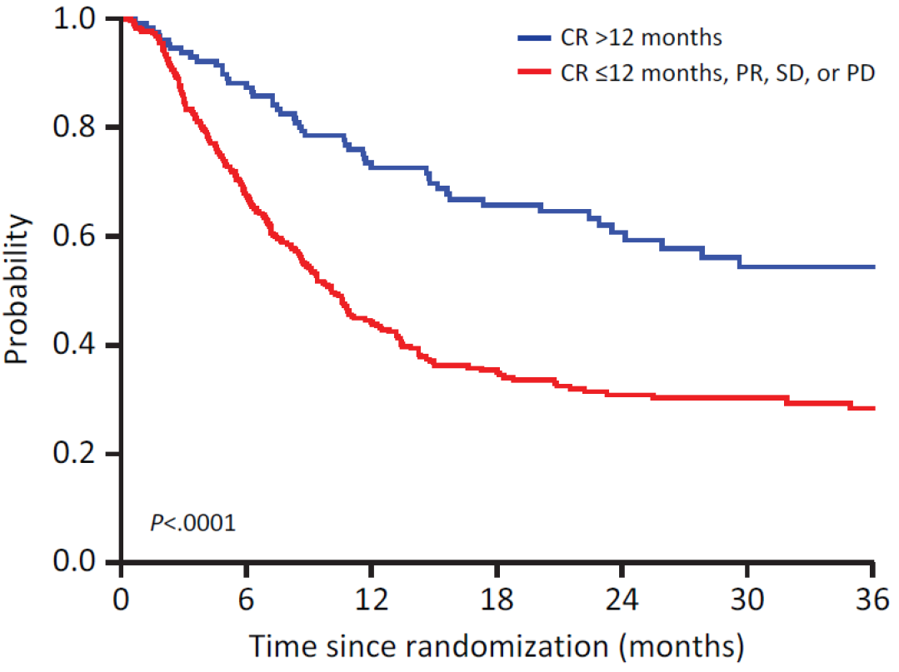
Prior Paradigm: Chemotherapy Followed by HDT-ASCT
For nearly 30 years, treatment for patients with refractory or relapsed Diffuse Large B-cell Lymphoma in the second-line curative setting was chemotherapy followed by HDT-ASCT
Most patients could not receive HDT-ASCT, and their prognosis was poor
Early R/R LBCL (ORCHARRD)
CR >12 months
CR ≤12 months, PR, SD, or PD
Probability of Overall Survival
Median OS ~10 months
P<0.0001
Time Since Randomization, Months

Slide 4
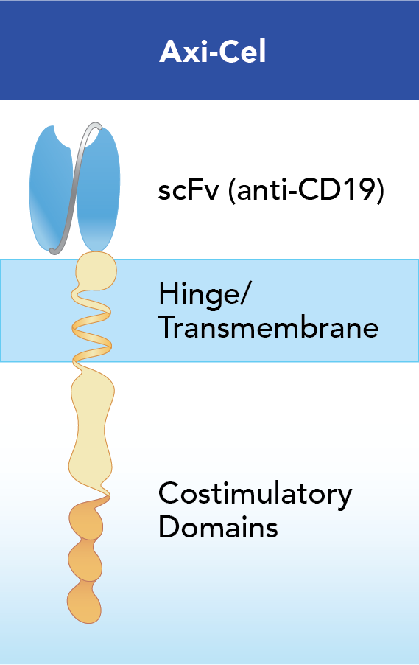
New Paradigm: Axi-Cel in Second-Line R/R LBCL
In the ZUMA-7 trial, axi-cel (autologous CAR T-cell) was superior to chemotherapy/HDT-ASCT in second-line LBCL for the primary endpoint of EFS (HR, 0.398; P<0.0001)
Based on superior EFS, axi-cel was approved in many countries for adults with R/R LBCL ≤12 months after first‐line therapy, in addition to after ≥2 lines of therapy
Here, we present the primary overall survival analysis of ZUMA-7

Slide 5
ZUMA-7 Study Schema and Endpoints
R/R LBCL
N=359
77 sites
Key Eligibility:
Aged ≥18 y
LBCL¹
R/R ≤12 mo of 1L therapyª
Intended to proceed to HDT‐ASCT
Stratification:
Response to 1L therapy
Second-line age-adjusted IPI (sAAIPI)
Optional Steroid-Only Bridging (No Chemotherapy)
Initial Disease Assessment (Day 50)
Day 100 Assessment
Day 150 Assessment
LTFU Assessment
Primary Endpoint
EFS^{d} by blinded central review
Key Secondary Endpoints
ORR
OS
Secondary Endpoints
PFS
Safety
PROs
No Protocol-Specified Crossover
Axi-Cel (n=180)
Conditioning Chemotherapy + Axi‐Cel^{b}
1:1 Randomization
Responders
(CR or PR)
Proceed to HDT‐ASCT
SOC (n=179)
Cycle 1
Cycle 2
Cycle 3
(Optional)
Nonresponders
Additional Treatment Off Protocol
Investigator-Selected Platinum-Based Chemoimmunotherapy^{c}

Slide 6
Baseline Characteristics Were Generally Balanced Between Axi-Cel and Standard of Care
Characteristic | Axi-Cel n=180 | SOC n=179 | Overall N=359
Median age (range), years | 58 (21-80) | 60 (26-81) | 59 (21-81)
≥65 years, n (%) | 51 (28) | 58 (32) | 109 (30)
Disease stage III-IV, n (%) | 139 (77) | 146 (82) | 285 (79)
sAAIPI of 2-3ª, n (%) | 82 (46) | 79 (44) | 161 (45)
Response to 1L therapyª, n (%)
Primary refractory | 133 (74) | 131 (73) | 264 (74)
Relapse ≤12 mo of 1L therapy | 47 (26) | 48 (27) | 95 (26)
Prognostic marker per central laboratory, n (%)
HGBL (including double-hit lymphomas) | 32 (18)^{b} | 25 (14) | 57 (16)^{b}
Double expressor lymphoma | 57 (32) | 62 (35) | 119 (33)
MYC rearrangement | 15 (8) | 7 (4) | 22 (6)
Elevated LDH level^{c} | 101 (56) | 94 (53) | 195 (54)

Slide 7
Nearly 3X Patients Received Axi-Cel Versus HDT-ASCT
Enrolled (Randomized)
N=359
Axi-Cel Arm
n=180
SOC Arm
n=179
Reasons Not Received
Patient request (n=8)
Lost to follow-up (n=1)
Other (n=2)
Reasons Did Not Undergo Leukapheresis
PD (n=1)
Other (n=1)
Underwent Leukapheresis
n=178
Received ≥1 Dose of Salvage Chemotherapy
n=168
Reasons for Not Proceeding
PD (n=56)
SD (n=27)
AE (n=1)
Other (n=4)
Reasons Not Received
AE (n=2)
Death (n=2)
PD (n=1)
Other (n=1)
Received Lymphodepleting Chemotherapy
n=172
Responded to Salvage Chemotherapy
n=80
Reasons Did Not Undergo Leukapheresis
PD (n=9)
AE (n=1)
Insufficient response (n=1)
Responded to Salvage Chemotherapy and Underwent Leukapheresis
n=69
Reasons Not Received
AE (n=2)
Received Axi-Cel Infusion
n=170
Received HDT-ASCT
n=64
Reasons HDT Not Received
PD (n=5)
94% Received Axi-Cel
36% Received HDT-ASCT

Slide 8
Nearly 3X Patients Received Axi-Cel Versus HDT-ASCT
Enrolled (Randomized)
N=359
Axi-Cel Arm
n=180
SOC Arm
n=179
Underwent Leukapheresis
n=178
Received ≥1 Dose of Salvage Chemotherapy
n=168
Received Lymphodepleting Chemotherapy
n=172
Responded to Salvage Chemotherapy
n=80
Responded to Salvage Chemotherapy and Underwent Leukapheresis
n=69
Received Axi-Cel Infusion
n=170
Received HDT-ASCT
n=64
94% Received Axi-Cel
36% Received HDT-ASCT
57% Received 3L+ Cellular Immunotherapy (Off Protocol)

Slide 9
Hierarchical Statistical Testing of Endpoints in ZUMA‐7: EFS → ORR → OS
EFS Primary Analysis
OS Primary Analysis
Enrollment
Data Cutoff: Mar 18, 2021
Jan 25, 2018
Oct 4, 2019
EFS Primary Analysis
Prespecified
Intent-to-Treat OS Primary Analysisª
ORR Primary Analysis
OS Interim Analysis

Slide 10
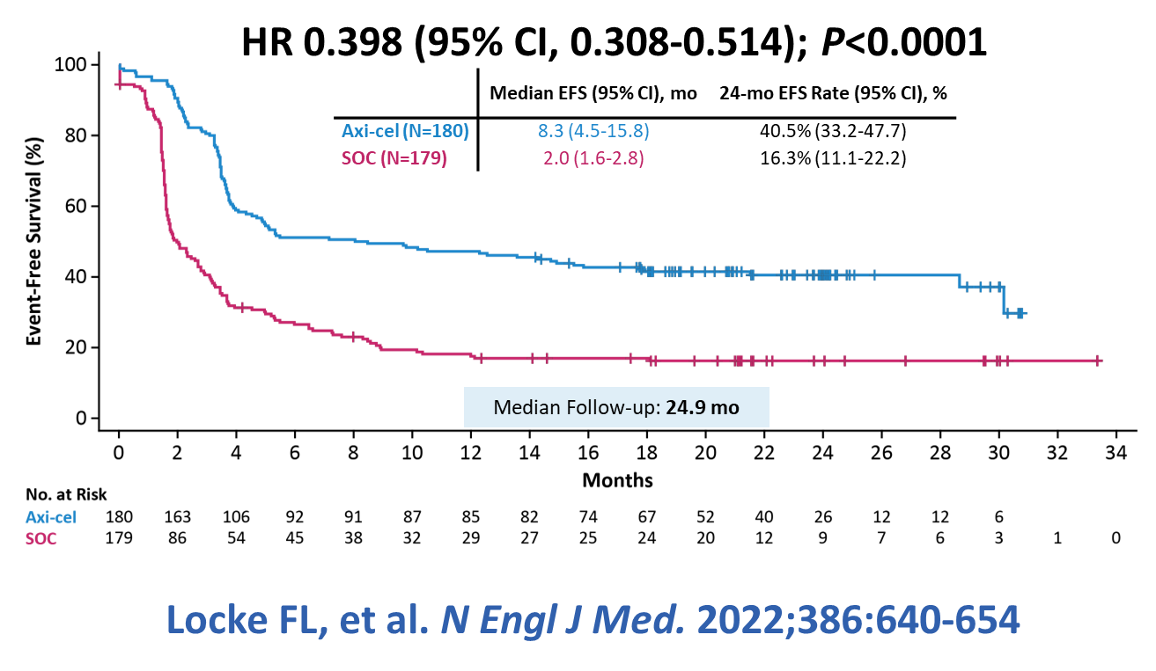
Hierarchical Statistical Testing of Endpoints in ZUMA‐7: EFS → ORR → OS
EFS Primary Analysis
OS Primary Analysis
Enrollment
Data Cutoff: Mar 18, 2021
Jan 25, 2018
Oct 4, 2019
EFS Primary Analysis
Prespecified
Intent-to-Treat OS Primary Analysis
ORR Primary Analysis
OS Interim Analysis

Slide 11
Hierarchical Statistical Testing of Endpoints in ZUMA‐7: EFS → ORR → OS
EFS Primary Analysis
OS Primary Analysis
Enrollment
Data Cutoff: Mar 18, 2021
Data Cutoff: Jan 25, 2023
Jan 25, 2018
Oct 4, 2019
EFS Primary Analysis
Prespecified
Intent-to-Treat OS Primary Analysis
ORR Primary Analysis
OS Interim Analysis

Slide 12
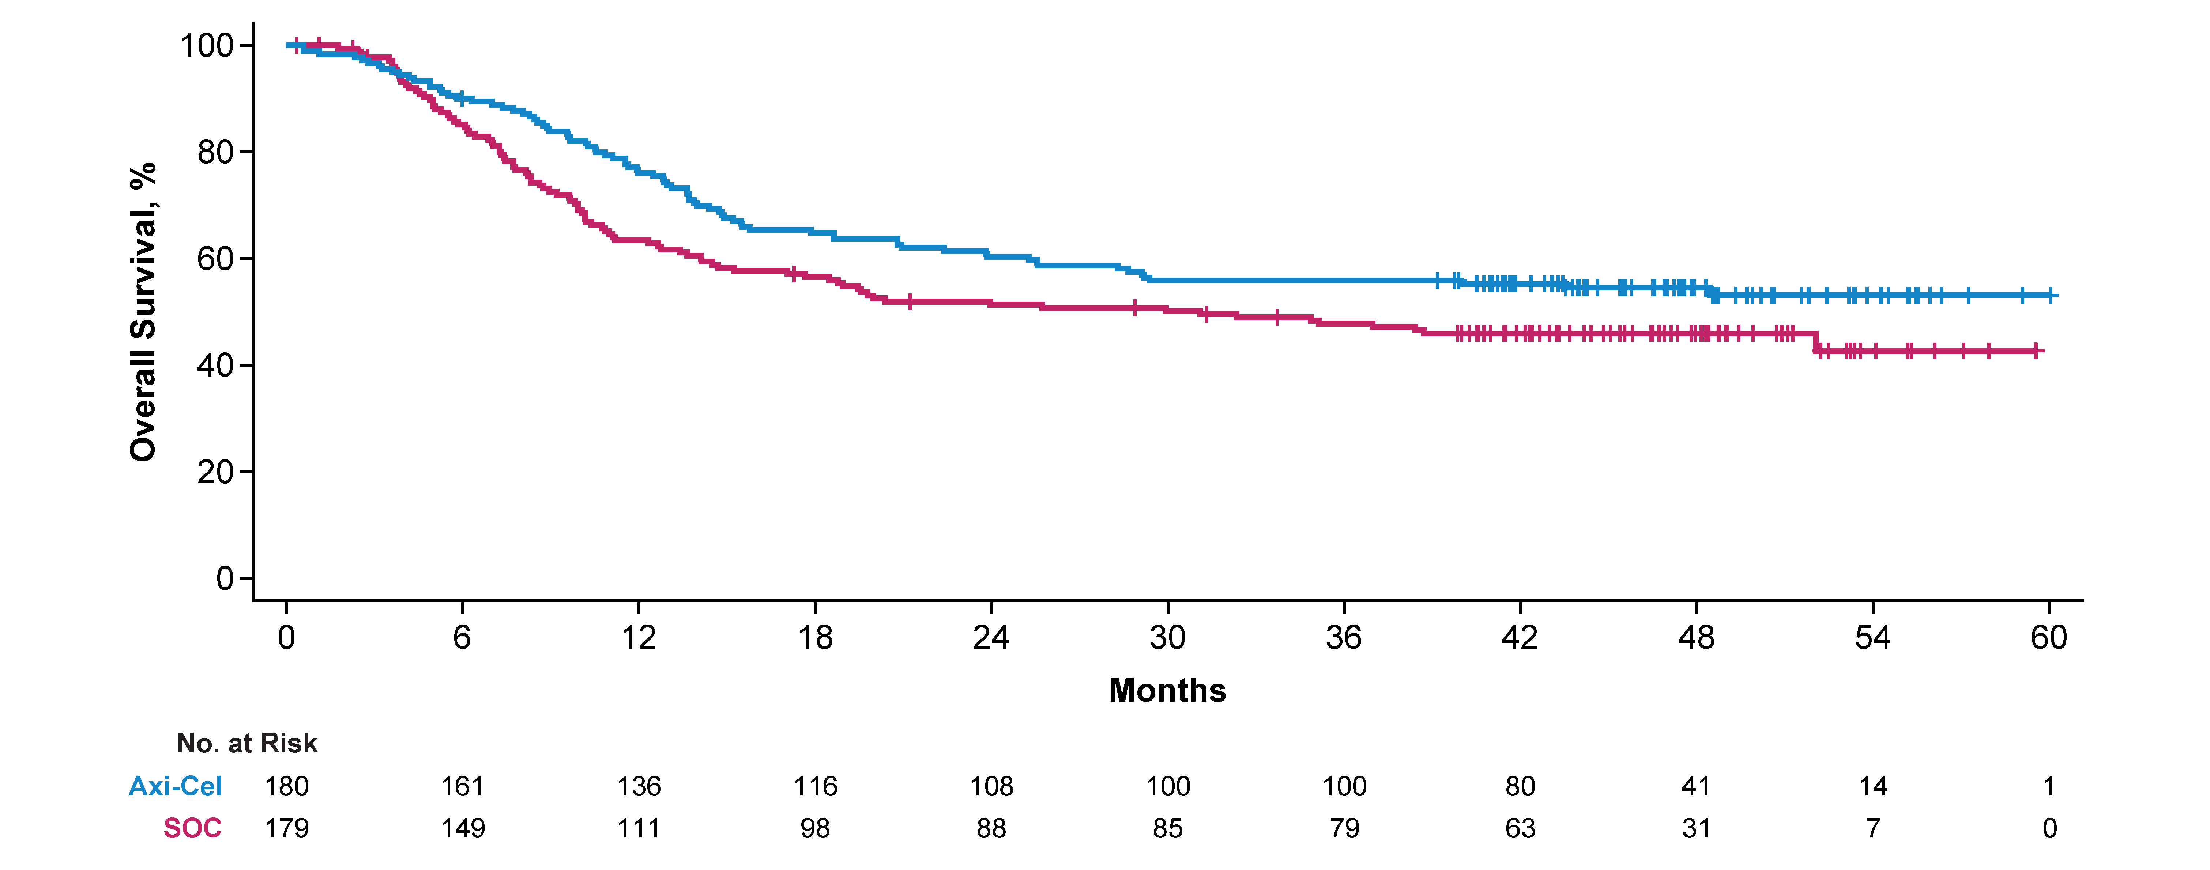
Axi-Cel Improved Overall Survival Versus Standard of Care
HR 0.726
(95% CI, 0.540-0.977); one-sided P=0.0168
Median Follow-up: 47.2 months

Slide 13
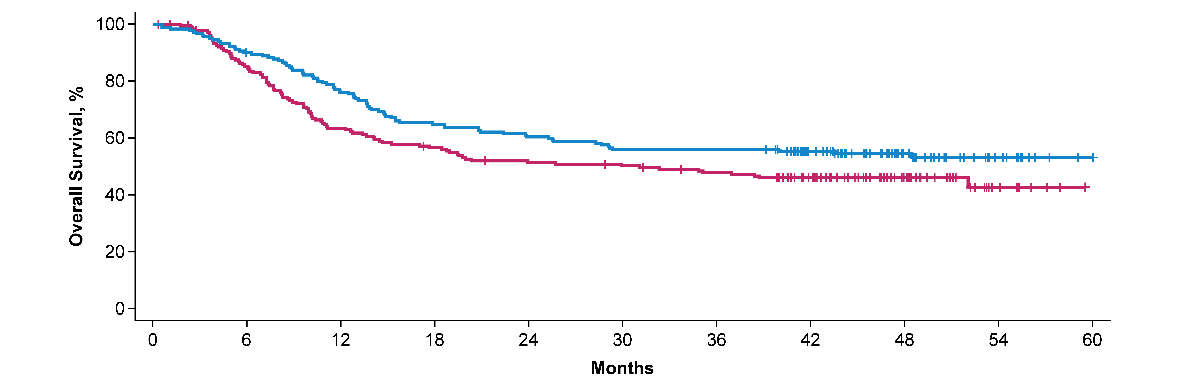
Axi-Cel Improved Overall Survival Versus Standard of Care
HR 0.726
(95% CI, 0.540-0.977); one-sided P=0.0168
Not Reached
Median OS
31 mo
Median Follow-up: 47.2 months
57% (n=102/179) of SOC patients received subsequent cellular immunotherapy (off protocol)
Historical SOC trials had lower OS rates in early R/R LBCL, including median OS of ~10 months in ORCHARRDª

Slide 14
Axi-Cel Improved Overall Survival Versus Standard of Care
HR 0.726
(95% CI, 0.540-0.977); one-sided P=0.0168
27.4% Reduction in Risk of Death
54.6%
4-Year
46.0%
57% Received 3L+ Cellular Immunotherapy (Off Protocol)
Median Follow-up: 47.2 months
57% (n=102/179) of SOC patients received subsequent cellular immunotherapy (off protocol)
Despite the increased survival in the SOC arm versus historical studies, axi-cel increased survival over SOC^{a,b}

Slide 15
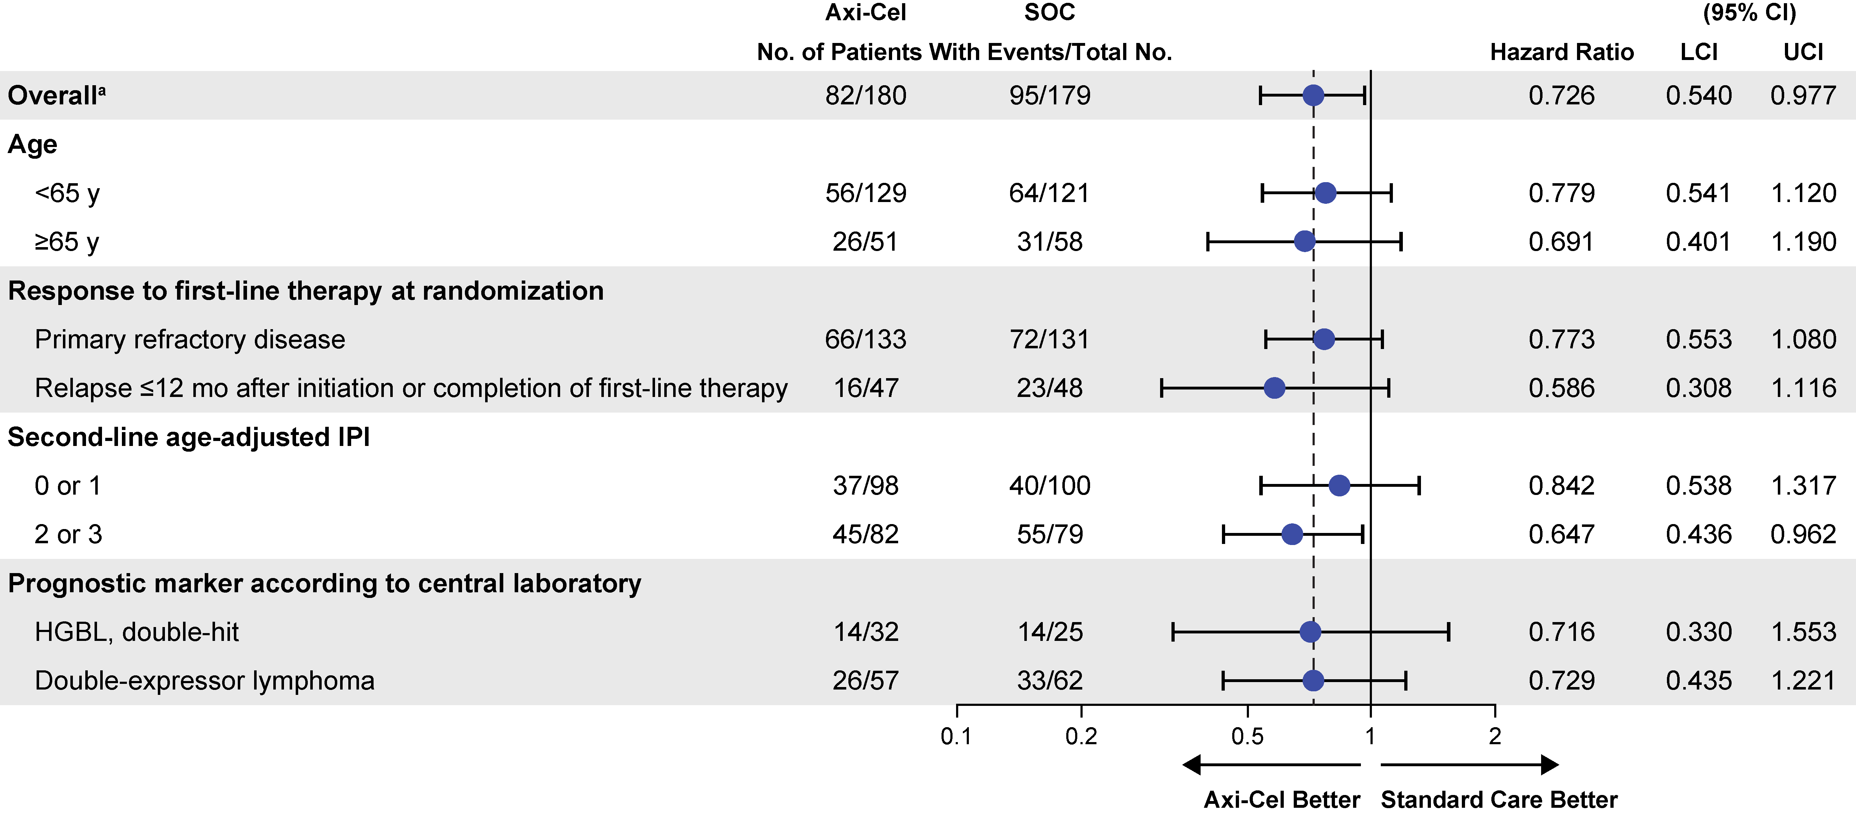
Survival Benefit Favoring Axi-Cel Was Similar Across Key Prespecified Subgroups

Slide 16
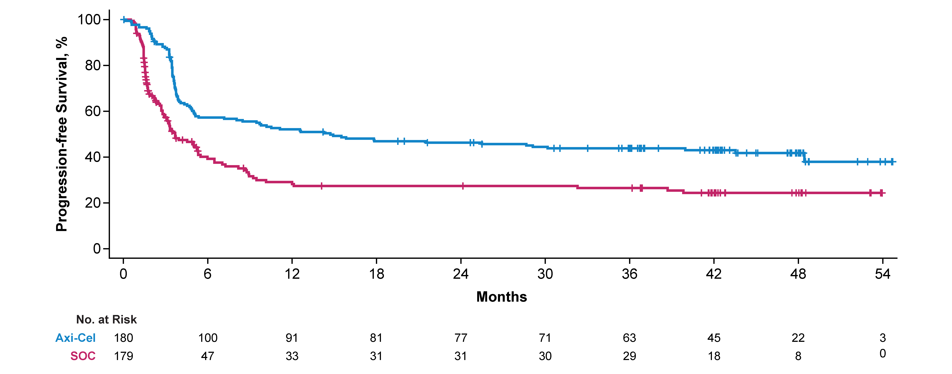
PFS By Investigator Confirmed Benefit of Axi-Cel Over SOC
HR 0.506
(95% CI, 0.383-0.669); descriptive one-sided P<0.0001
Median Follow-up: 47.2 months

Slide 17
PFS By Investigator Confirmed Benefit of Axi-Cel Over SOC
HR 0.506
(95% CI, 0.383-0.669); descriptive one-sided P<0.0001
14.7 mo
Median PFS
3.7 mo
Median Follow-up: 47.2 months

Slide 18
PFS By Investigator Confirmed Benefit of Axi-Cel Over SOC
HR 0.506
(95% CI, 0.383-0.669); descriptive one-sided P<0.0001
4-Year
41.8%
24.4%
Median Follow-up: 47.2 months

Slide 19
Key Safety Data At Primary Overall Survival Analysis
AEs of Interest, % | Axi-Cel n=170 |  | SOC n=168
 | Any Grade | Grade ≥3 | Any Grade | Grade ≥3
CRS | 92% | 6% | – | –
Neurologic event | 61% | 21% | 20% | 1%
Hypogammaglobulinemia | 11% | 0% | 1% | 0%
Cytopenia | 80% | 75% | 80% | 75%
Infections | 45% | 16% | 32% | 12%
Reason for Death | Axi-Cel n=170 | SOC n=168
Progressive disease, n (%) | 51 (30) | 71 (42)
Grade 5 AE during protocol-specific reporting period, n (%) | 8 (5)ª | 2 (1)^{b}
New or secondary malignancy, n (%) | 2 (1)^{c} | 0
Other reason for death,^{d} n (%) | 13 (8) | 18 (11)
Definitive therapy-related mortality,^{e} n/N (%) | 1/170 (1)^{f} | 2/64 (3)^{g}
No changes in cumulative treatment‐related serious or fatal AEs occurred since the primary EFS analysis

Slide 20
Paradigm Shift: Axi-Cel Improves Overall Survival in 2L LBCL
Axi-cel improves overall survival in 2L for early R/R LBCL vs previous paradigm
  Risk of death reduced by 27.4% with axi-cel vs chemotherapy and HDT-ASCT, despite 57% subsequent cellular immunotherapy after standard of care
  Overall survival benefit was similar across key patient subgroups
With median follow-up of 47.2 months, data are consistent with curative therapy
First trial in nearly 30 years in 2L to significantly improve overall survival
ZUMA-7 confirms axi-cel is a second‐line standard of care for patients with refractory or early relapsed large B-cell lymphoma based on superior survival

Slide 21
Paradigm Shift: Axi-Cel As Second-Line Standard of Care
The New LBCL Algorithm
Time From 1L Therapy
≤1 Year: ≈75%
>1 Year: ≈25%
Eligible for CAR T-Cell Therapy?
Eligible for ASCT?
CAR T-cell Therapy Approved in 2L
2 or 3L+ Therapy Options
Investigational agent/regimen
Immunochemotherapy
CAR T-cell therapy
Polatuzumab vedotin + BR
Selinexor
Tafasitamab + lenalidomide
Loncastuximab tesirine
Best supportive care or XRT
2L Salvage
± ASCT
Axi-Cel Improves OS
Over 2L Chemo ± ASCT
Cure
Cure

Slide 22
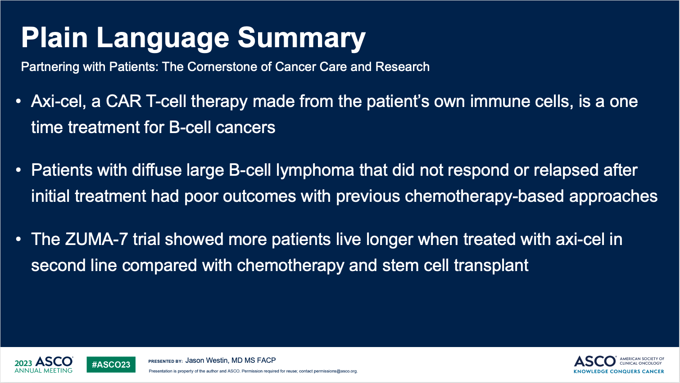

Slide 23
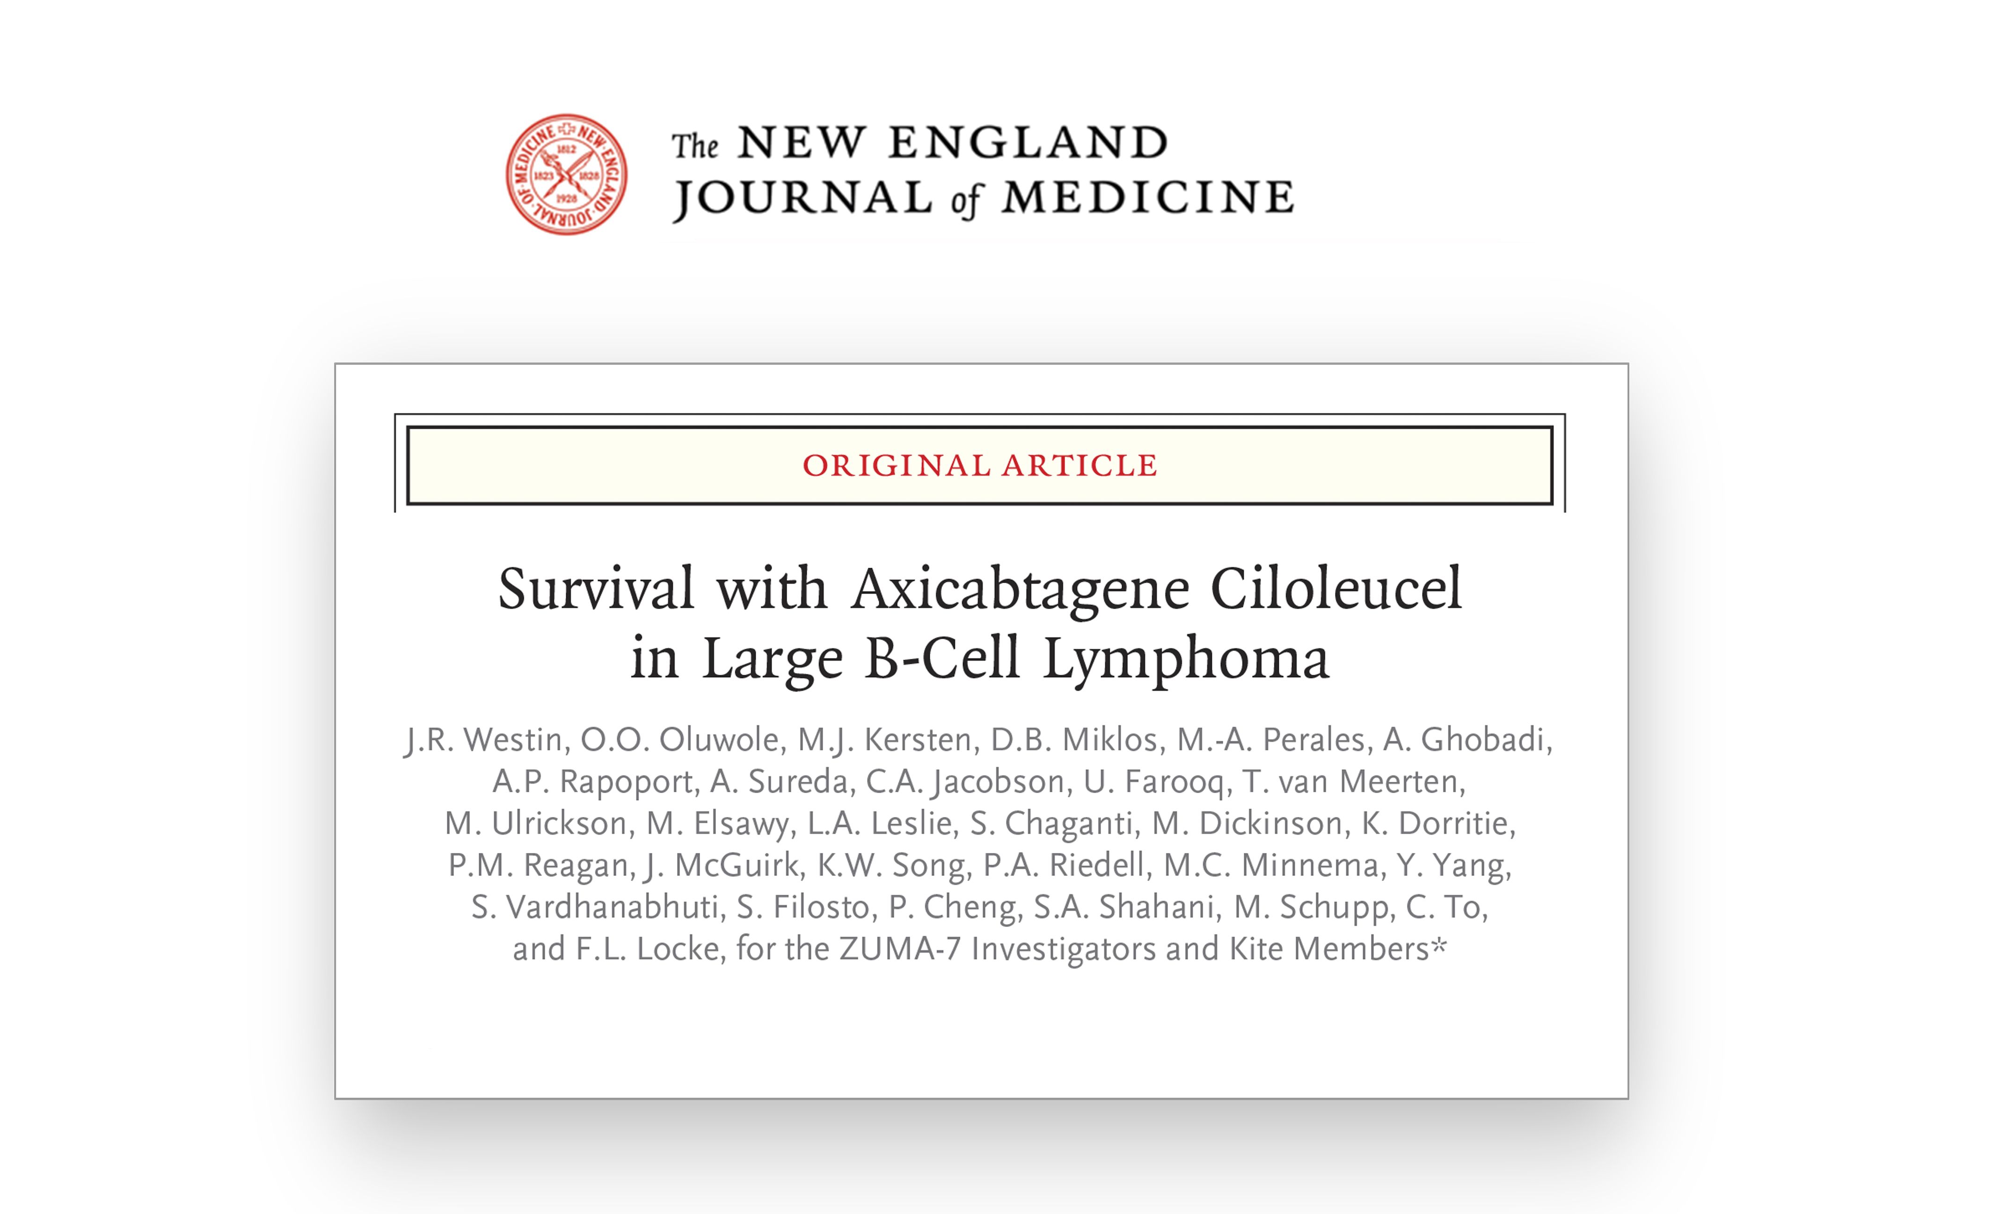

Slide 24
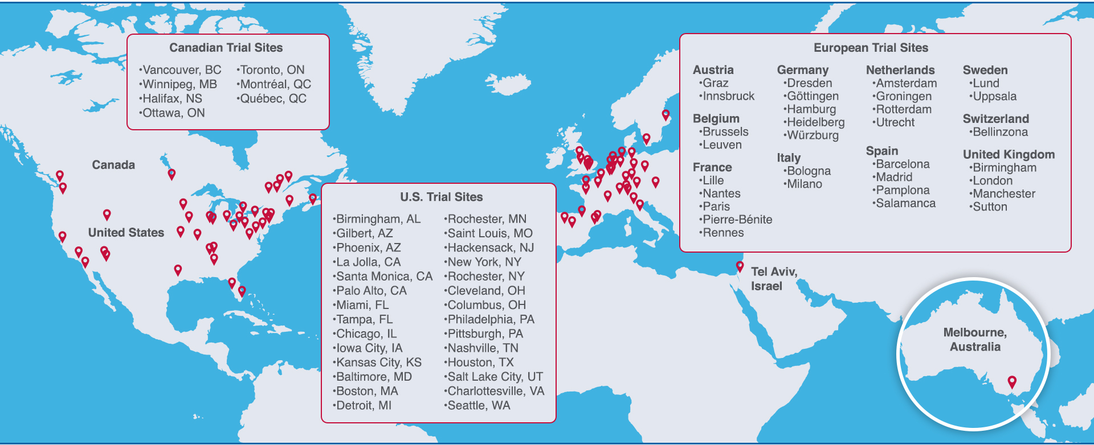

Acknowledgments
The volunteers, families, friends, and caregivers
The entire ZUMA-7 study team of investigators, coordinators, and health care staff at each study site
Medical writing support was provided by Patricia Johansen, PhD, of Kite, and Ashley Skorusa, PhD, Alberto Moldón, PhD, and Robert Rydzewski, MS, of Nexus Global Group Science LLC, funded by Kite
All employees of Kite involved over the course of the study for their contributions
ZUMA-7 Global Phase 3 Clinical Trial Sites
Author disclosure information is available from the abstract online
Copies of this slide deck obtained through Quick Response (QR) Code are for personal use only and may not be reproduced without permission from ASCO® or the author of these slides

