Slide 1
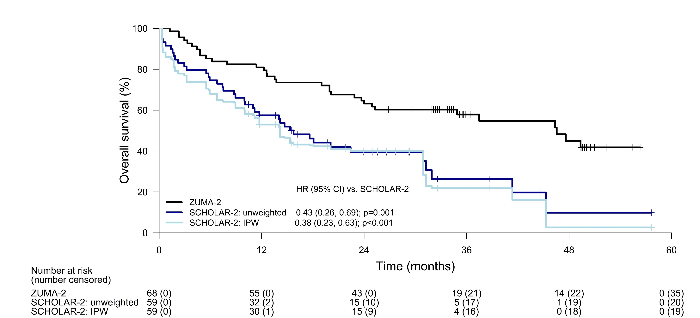
A Comparison of Overall Survival with Brexucabtagene Autoleucel (Brexu-cel) CAR T-Cell Therapy (ZUMA-2) and Standard of Care (SCHOLAR-2) in Patients with Relapsed/Refractory Mantle Cell Lymphoma (R/R MCL) Previously Treated with a Covalent Bruton Tyrosine Kinase Inhibitor (BTKi)
G. Hess,¹ M. Dreyling,² L. Oberic,³ E. Gine,⁴ P.L. Zinzani,⁵ K. Linton,⁶ A. Vilmar,⁷ M. Jerkeman,⁸ J.M.H. Chen,⁹ A. Ohler,¹ S. Stilgenbauer,¹⁰ C. Thieblemont,¹¹ J. Lambert,¹² V.R. Zilioli,¹³ J.M. Sancho,¹⁴ A. Jiménez-Ubieto,¹⁵ L. Fischer,² T.A. Eyre,¹⁶ S. Keeping,⁹ J.E. Park,⁹ J.J Wu,¹⁷ R. Siddiqi,¹⁷ J. Reitan,¹⁸ G. Castaigne¹⁷ and G. Salles¹⁹
¹Department of Hematology, Oncology and Pneumology, Comprehensive Cancer Center, University Medical School of the Johannes Gutenberg-University, Mainz, Germany, ²Medizinische Klinik III, LMU Klinikum, Munich, Germany, ³Service d’Hématologie, Toulouse, France, ⁴GELTAMO, Hematology Department, Hospital Clínic of Barcelona, Barcelona, Spain, ⁵IRCCS Azienda Ospedaliero-Universitaria di Bologna Istituto di Ematologia “Seràgnoli”, Dipartimento di Medicina Specialistica, Diagnostica e Sperimentale, Università di Bologna, Bologna, Italy, ⁶The Manchester Cancer Research Center, Manchester, United Kingdom, ⁷Odense University Hospital, Odense, Denmark, ⁸Department of Oncology, Skane University Hospital and Lund University, Lund, Sweden, ⁹PRECISIONheor, Vancouver, Canada, ¹⁰Department of Internal Medicine III, Ulm University, Ulm, Germany, ¹¹APHP, Hôpital Saint-Louis, Hemato-oncologie; Université de Paris, Paris, France, ¹²University College London Hospitals NHS Foundation Trust, London, United Kingdom, ¹³Division of Hematology, ASST Grande Ospedale Metropolitano Niguarda, Milano, Italy, ¹⁴GELTAMO, Institut Català d’Oncologia, Hospital Germans Trias i Pujol, Badalona, Spain, ¹⁵GELTAMO, Hospital Doce de Octubre, Madrid, Spain, ¹⁶Oxford University Hospitals, Oxford, UK, ¹⁷Kite, a Gilead Company, Santa Monica, CA, USA, ¹⁸RJM Group, LLC, Crown Point, USA, ¹⁹Department of Medicine, Memorial Sloan Kettering Cancer Center, New York, USA
INTRODUCTION
Indirect comparisons – Overall Survival
Naïve (unadjusted) analysis
Median OS was 46.6 (95% CI: 24.9, not estimable) months for brexu-cel and 15.7 (95% CI: 10.0, 30.9) months for SOC, with a 1-year OS estimate of 80.9% and 57.5% respectively.
The unadjusted analysis suggested that brexu-cel was more effective compared to SOC with an OS HR of 0.43 (95% CI: 0.26, 0.69; P=0.001).
IPW base-case analysis
Baseline characteristics before and after applying weights in the base-case analysis (IPW approach) are shown in Table 1.
The following covariates were included in the final model: male sex, prior autologous stem cell transplantation, number of prior lines of therapies, duration of prior BTKi, response to prior BTKi therapy, and disease stage.
With IPW, the adjusted OS KM curve for SOC shifted slightly downward, with a median OS of 14.2 (95% CI: 6.8, 30.9) months (Figure 1).
Similar to the unadjusted results, the IPW-adjusted OS HR of 0.38 (95% CI: 0.23, 0.63; P<0.001) suggested that brexu-cel reduced the risk of death relative to SOC.
Figure 1: Kaplan-Meier estimates of overall survival with brexu-cel (ZUMA-2) and SOC (SCHOLAR-2); IPW base-case analysis
Note: The weights for ‘SCHOLAR-2: IPW’ patients were standardized so that the rescaled weights are relative to the original unit weights of each SCHOLAR-2 patient; as such, the numbers at risk for both ‘SCHOLAR-2: unweighted’ and ‘SCHOLAR-2: IPW’ are the same at time=0. In the actual analysis, the unscaled conventional weights were used. Abbreviations: CI, confidence interval; HR, hazard ratio; IPW, inverse probability weighting; SOC, standard of care
Multivariable regression sensitivity analysis
The final MVR model included treatment, duration of prior BTKi therapy, and ECOG PS; again, the estimated OS HR of 0.46 (95% CI: 0.28, 0.75; P=0.002) suggested that brexu-cel reduced the risk of death relative to SOC.
Doubly robust method sensitivity analysis
The final DR model included treatment, number of prior therapies, duration of prior BTKi, and ECOG PS; the estimated OS HR of brexu-cel versus SOC was 0.36 (95% CI: 0.22, 0.58; P<0.001), again, suggested that brexu-cel reduced the risk of death relative to SOC.
Patients with MCL typically require multiple lines of therapy and have poor prognosis, especially after having failed BTKi therapy.¹ There are limited published survival data for patients with R/R MCL in the post-BTKi setting and small retrospective studies have reported median overall survival (OS) ranging from 5.8 to 12.5 months.^{2–6}
Here, we aim to compare the efficacy, in terms of OS, of brexu-cel (an anti-CD19 CAR T-cell therapy, formerly known as KTE-X19) versus standard of care (SOC) in patients with R/R MCL post-BTKi using individual patient data from both ZUMA‑2 and SCHOLAR-2.
SCHOLAR-2 is a retrospective, observational study reporting OS among 240 patients with R/R MCL who received covalent BTKi therapy between July 2012–July 2018 in 7 European countries (Denmark, France, Germany, Italy, Spain, Sweden, and the UK) and either had disease progression while on BTKi therapy or discontinued BTKi therapy due to intolerance, and SCHOLAR-2 data reflects recent clinical practice (excluding chimeric antigen receptor [CAR] T-cell therapies), thus providing a benchmark for indirect treatment comparisons of newer agents to SOC.⁷
ZUMA-2 is a phase 2 multicenter, single-arm trial investigating the efficacy and safety of brexu-cel in patients with R/R MCL who had 1–5 prior therapies, including a BTKi; updated clinical efficacy results based on ZUMA-2 3-year follow-up (N=68 treated patients) were used for this analysis.⁸
METHODS
Time-points (months) | Overall survival rate, % (95% CI)
Time-points (months) | ZUMA-2 | SCHOLAR-2: unweighted | SCHOLAR-2: IPW
6 | 85.3 (74.4, 91.8) | 74.6 (61.4, 83.8) | 68.1 (50.9, 80.3)
12 | 80.9 (69.4, 88.4) | 57.5 (43.9, 68.9) | 52.9 (36.5, 66.9)
18 | 73.5 (61.3, 82.4) | 46.1 (32.8, 58.4) | 42.8 (27.3, 57.3)
24 | 63.2 (50.6, 73.4) | 39.5 (26.4, 52.2) | 40.0 (24.8, 54.7)
30 | 60.3 (47.7, 70.8) | 39.5 (26.4, 52.2) | 40.0 (24.8, 54.7)
36 | 57.9 (44.9, 68.9) | 26.3 (12.9, 41.8) | 21.8 (7.7, 40.5)
42 | 54.7 (40.9, 66.5) | 19.7 (7.0, 37.2) | 16.1 (4.1, 35.2)
48 | 45.0 (30.2, 58.7) | 9.9 (1.0, 31.3) | 2.6 (0.1, 14.1)
Statistical Analysis
Indirect comparisons were conducted using three different statistical methods which adjusted for imbalances in prognostic factors between the two non-randomized study populations: 1) inverse probability weighting (IPW) with ZUMA-2 as the target population, 2) multivariable regression (MVR), and 3) doubly robust (DR) method.
IPW method (base case analysis): weights were generated from the model among all possible propensity score models which provided i) an absolute standardized difference of <10% for the four pre-specified prognostic factors (bolded in Table 1) and ii) the minimum sum of absolute standardized differences.
MVR and DR method (sensitivity analyses): univariate Cox models were first performed to identify potential confounders for OS (P<0.3); backward elimination was then performed to build a parsimonious model based on the Akaike Information Criterion.
OS was measured from the date of brexu-cel infusion in ZUMA-2 and initiation of the first post-BTKi therapy (i.e., index SOC) in SCHOLAR-2.
As there was no strong evidence of non-proportional hazards based on Schoenfeld residuals and visual inspection of plots of the log cumulative hazards, relative treatment effects were estimated from Cox models and summarized as hazard ratios (HRs) with 95% confidence intervals (CIs).
RESULTS
Evidence base
Prior to the analyses, key eligibility criteria from the ZUMA-2 trial, i.e., Eastern Cooperative Oncology Group performance status (ECOG PS) score of 0–1 and a minimum of 12-month potential follow-up from initiation of active therapy post-BTKi, were first applied to the SCHOLAR-2 population to construct an SOC cohort (n=59 patients) that resembled patients in ZUMA-2.
Index SOC treatments received by the SCHOLAR-2 cohort included:
BTKi regimens (n=2), rituximab + bendamustine + cytarabine (n=5), bendamustine + rituximab (n=11), cytarabine-containing regimens (n=4), lenalidomide-containing regimens (n=11), bortezomib-containing regimens (n=7), other targeted therapy ± antibodies (n=12), other chemotherapy ± antibodies (n=5), and radiotherapy (n=2).
At baseline, the study populations were broadly comparable in terms of age, mean number of prior therapies, prior BTKi duration, and prior BTKi response (Table 1); the proportions of patients with prior autologous stem cell transplantation, Stage IV disease, and ECOG PS score of 0 were higher in ZUMA-2 compared to SCHOLAR-2.
Median follow-up times were 35.6 months for brexu-cel and 27.6 months for SOC.
Table 1: Baseline characteristics before and after applying weights; IPW base‑case analysis
Note: The final propensity score model provided the best balance in the key prognostic factors marked in bold (i.e., absolute standardized difference <10% for all four variables with the minimum sum of absolute standardized differences among all possible models). Abbreviations: BTKi, Bruton tyrosine kinase inhibitor; ECOG, Eastern Cooperative Oncology Group; ESS, effective sample size; IPW, inverse probability weighting; n, number of patients
CONCLUSION
These comparisons utilized the largest study to date of patients with R/R MCL treated with SOC after failing a BTKi therapy as well as long-term follow-up data (median 35.6 months) for patients treated with brexu-cel, and findings were robust across the three different adjustment methods.
Despite the limitations of an unanchored indirect treatment comparison based on non-randomized data, these updated results continue to suggest improved OS with brexu-cel versus SOC in patient with R/R MCL post-BTKi and may help inform treatment decisions in this high unmet need population.
REFERENCES
Variables | ZUMA-2 (n=68) | SCHOLAR-2: unweighted (n=59) | SCHOLAR-2: IPW (ESS=40.1)
Prior autologous stem cell transplantation (%) | 42.6 | 35.6 | 42.6
Number of prior lines of therapy, mean | 3.3 | 3.0 | 3.3
Duration of prior BTKi (months), mean | 11.4 | 11.9 | 11.2
Response to prior BTKi therapy (%) | 38.2 | 40.4 | 38.4
Age (years), mean | 63.2 | 64.3 | 63.4
Male sex (%) | 83.8 | 72.9 | 83.3
Stage IV disease (%) | 85.3 | 63.3 | 83.4
ECOG performance status 0 / 1 (%) | 64.7 / 35.3 | 45.8 / 54.2 | 48.1 / 51.9
1) Owen C et al. Curr Oncol. 2019;26(2):e233–e240. 2) Martin et al. Blood. 2016;127(12):1559–63. 3) McCulloch et al. Br J Haematol. 2020;189(4):684–8. 4) Eyre et al. Haematologica. 2019;104(2):e68–71. 5) Jain et al. Br J Haematol. 2018;183(4):578–87. 6) Cheah et al. Ann Oncol. 2015;26(6):1175–9. 7) Hess et al. Br J Haematol. 2022; 00:1–11. 8) Wang et al. J Clin Oncol. 2022; JCO2102370. Epub ahead of print. 9) Faria et al. NICE DSU TSD 17. 2015.
ACKNOWLEDGMENTS/CONTACT
This study was supported by Kite, a Gilead Company. Writing and editorial support was provided by PRECISIONheor, Vancouver, BC, Canada and funded by Kite, a Gilead Company.
Corresponding author: Georg Hess, georg.hess@unimedizin-mainz.de

